Slide 1
ONLINE TENDERING –
ENGLISH and DYNAMIC AUCTION –
SUPPLIER GUIDE
Düsseldorf
January 2024
Process Consulting Offer Solution:
Email: esourcing@sourcingsupport.de
Phone +49 211 969 4747
0 © METRO AG. Offer Sounding Board. For internal use only.

Slide 2
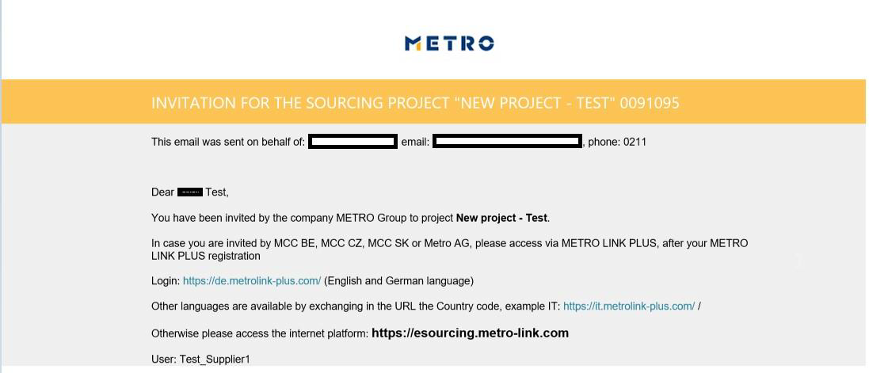
Introduction
You have been invited to participate in an English or Dynamic auction of Metro Group.
To submit your prices, you will be using the web-based eSourcingsoftware provided by METRO
For any technical questions concerning the platform please contact Offer Solutions Services:
Email: esourcing@sourcingsupport.de Phone +49 211 969 4747

Slide 3
How to Log-in to eSourcing:
Log-in to eSourcing using one of the methods below:
Log-in via Metro Link Plus [Suppliers onboarded in MLP]
Other languages are available by exchanging in the URL the Country Code
Example: https://it.metrolink-plus.com/
Direct log-in via eSourcing [Suppliers not onboarded in MLP]
Please click here for more log-in instructions

Slide 4
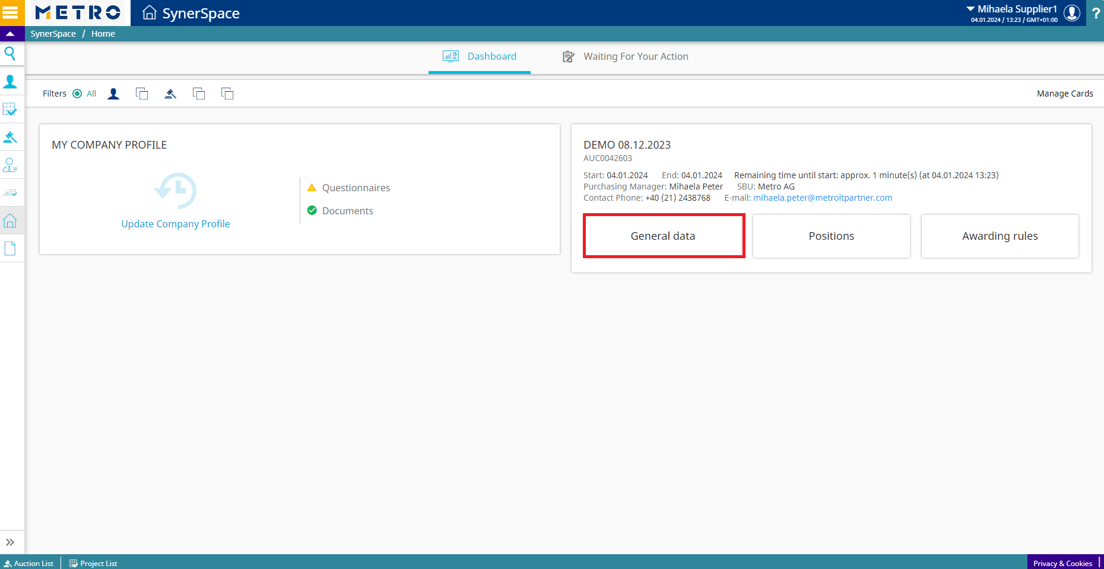
eSourcing HOME page
After clicking the eSourcing icon in Metro Link Plus, you will be redirected to eSourcing home page.
In this page you will see the projects and auctions you are invited to
Please click “General data” to access the Auction

Slide 5
Alternative way to find the Auction
You can also click on “Menu” and navigate to “Auctions”-”Auction List” to find the Auctions you are invited to
Or you can click Auction List on the bottom of your screen

Slide 6
How to open the Auction
Please click on the grey folder with “+” to open the Auction

Slide 7
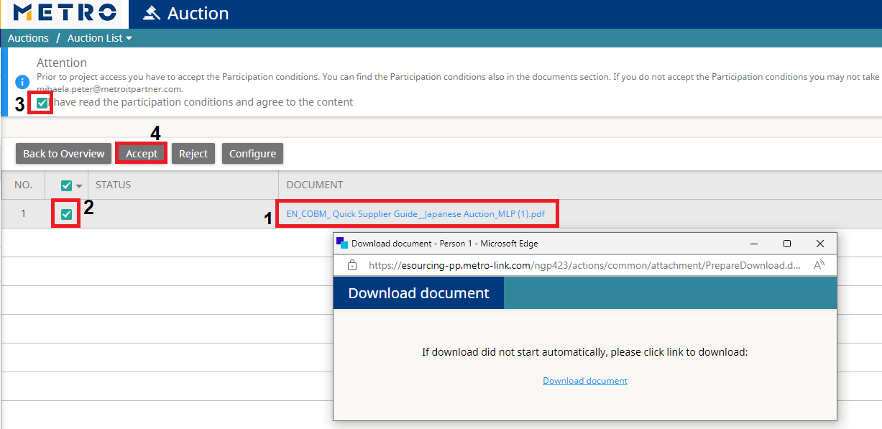
How to accept General Conditions
For you to be able to participate to the Auction you must accept the “General Conditions”
Please ensure you download, and open the documents set as GC (1)
In case of more than 1 document or in case of a zip file that contains many documents, it is still mandatory to download, open and accept all the documents.
Select all Document lines (2) , tick on “I have read the participation conditions”(3) and click on “Accept” (4).
Please read all documents carefully and be aware that once the documents are confirmed,
they are legally signed and don’t need to be manually signed. After this confirmation you are able to participate in the auction. In case you disagree with the content of the document, contact the buyer asap.

Slide 8
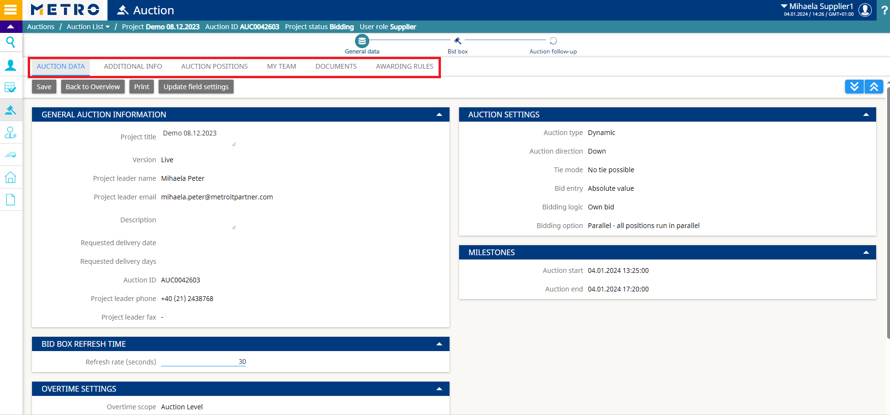
General Information
After accepting the general conditions, you will have access to the following tabs:
Auction data
Additional info
Auction positions: articles to be negotiated.
My Team: list of members of your company that are invited to the project.
Documents: list of tender documents available for you for the project

Slide 9
Where to find Documents
In tab “documents” you can download and upload documents:
To download the documents: select the document and click on “download” (1)
You are also able to upload documents which you would like to share with the buyer (2)

Slide 10
Bid Box
During the auction you will be able to submit your bids in the Bid Box.
You can see the following information under this screen:
Start & end time, Refresh time and remaining time of the auction
Feedback provided by the Buyer such as best bid, lead, rank, own bid, start price, etc.
You can enter values per article in the column “Entry” (1) and then (2) click to confirm

Slide 11
Auction rules for DYNAMIC Auction
The rank or a color (green = best bid, red = not winning) is displayed to suppliers. You can enter a bid only lower than your previous own bids.

Slide 12
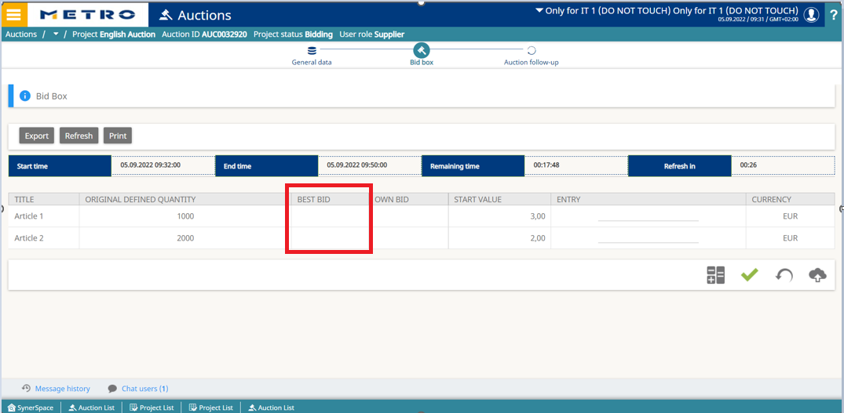
Auction rules for ENGLISH Auction
The best bid is displayed to suppliers. You can only enter a bid if it is lower than the current best bid.

Slide 13
How to logout from eSourcing
Click here to logout from eSourcing:

Slide 14
How to Contact us
If you face technical issues during a live auction, please immediately contact your buyer.
If you need any support to use the eSourcingplatform, please do not hesitate in contacting:
Process Consulting Offer Solution esourcing@sourcingsupport.de Hotline: +49 211 969 4747
Mo. –Thu.: 08:00 to 18:00
Fri.: 08:00 to 16:00

