Slide 1
Introduction to Local Tender template
Metro, October 2020

Slide 2
1. Using Right Template
Go to „Projects“
Click on „New“
Select the template „Local Tender Template“
Click on “Apply”

Slide 3
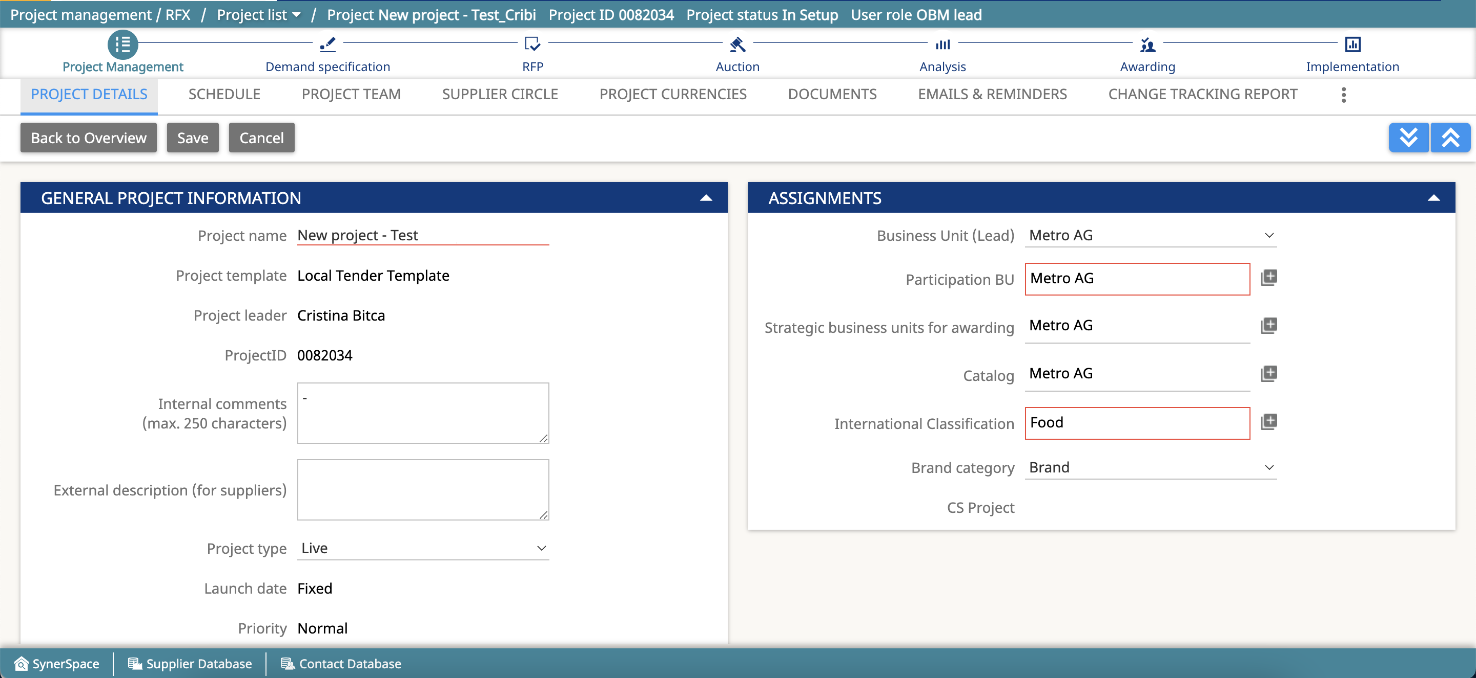
2. Project Details
Enter a project name.
If applicable enter a comment for the project team and/ or supplier.
Select the “International Classification”.
Select the “Brand Category”.
Click on “Save.
Please set ‘project currency’ for not EUR event, If multiple currency required please contact us
Project currency can be navigated by looking at the tabs.

Slide 4
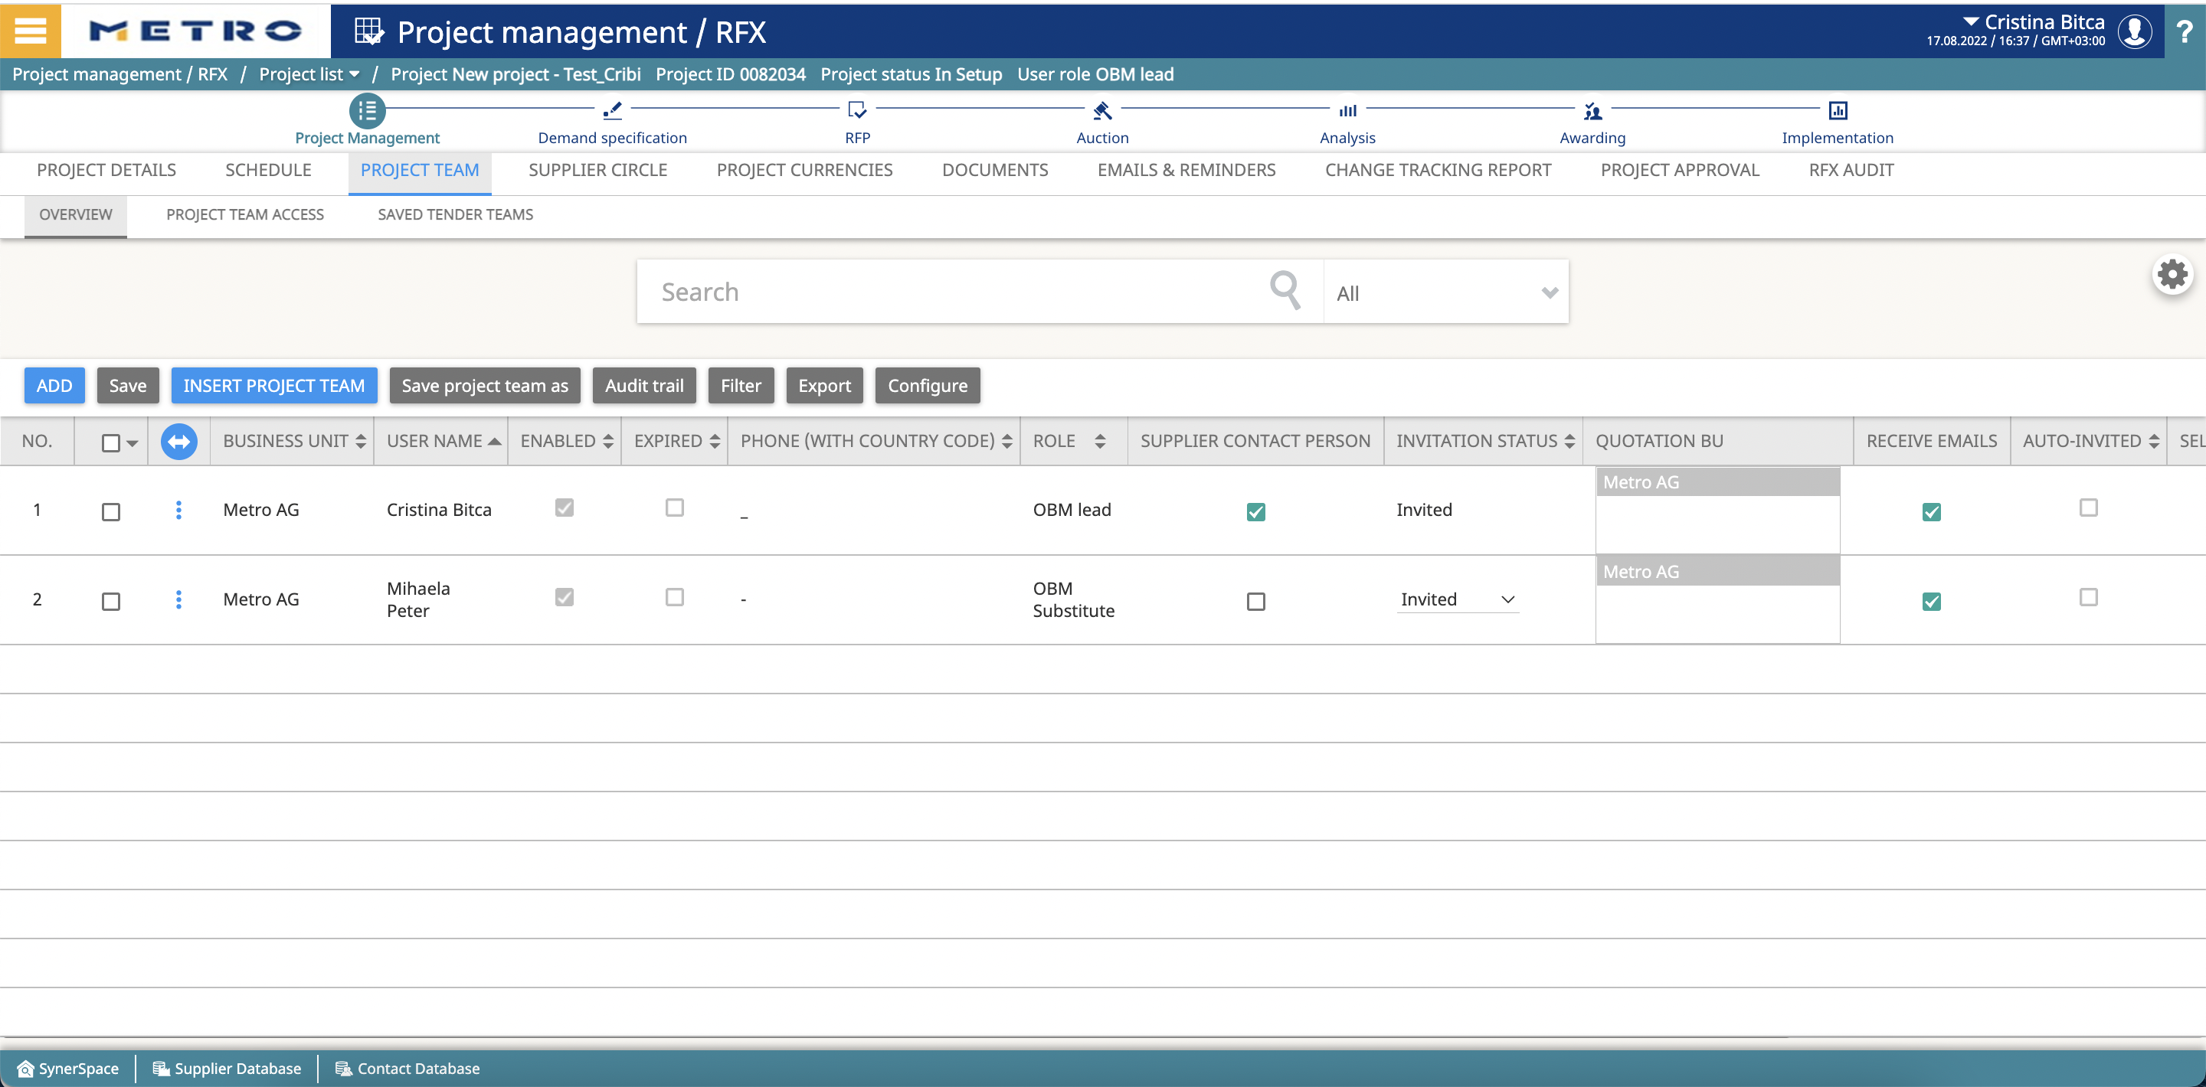
3.Project team
Click on „Add“
Search for your colleagues
Select your colleagues
Or Click on „Add to project team“ if you have one – contact us how to do it - or select your pre def. project team. You can save your project team (“Save project team as”) and reuse this project team (“Insert project team”) in your upcoming projects.

Slide 5
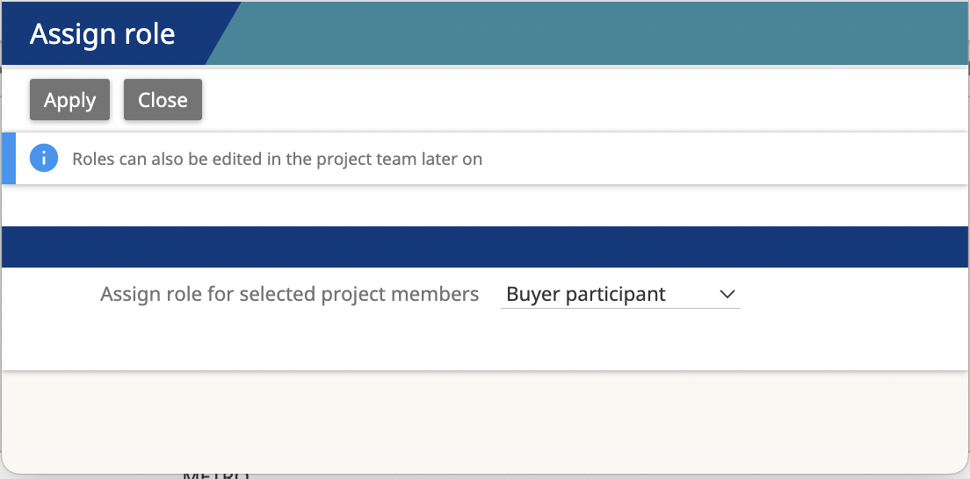
3.Define roles
Invite Buyers
Define buyer roles in this particular project :
Leader substitute has same right as the project leader
Guest role has no right on the project, only viewer
Project Assistant similar to leader substitute

Slide 6
4.INVITE SUPPLIER
Click on „Add“ - > Search for your supplier -> Select your suppliers
Or Click on „Insert supplier team“ if you have one and select your pre def. suppliers. You can save your supplier team (“Save supplier team as”) and reuse same supplier group (“Insert supplier team”) in your upcoming projects.
Click on “Add to current project”
Please use the SSR functionality (Supplier self-registration) if your supplier company do not have an account for eSourcing yet. New contacts can be added directly in supplier company.
-> Offer Solution Services offers training material for the SSR functionality.
For SSR, after click on icon „ADD“

Slide 7
5.DOCUMENT
Share documents with project team and or suppliers
Click on “Upload” or “Mass Upload” to upload documents (PDF format)
Click on “Set as GC “ to set a document as “General Conditions” are mandatory for each project and are uploaded under the tab “Documents” –for RFP and auctions.
Provide “Buyer access” to share the document only with your colleagues
Provide “Supplier access” to share the document with suppliers

Slide 8
6.Demand Specification
If your article exists in eSourcing Article database –renegotiate existing articles
Click on “Insert existing articles”
Search for your articles
Select your articles
Click on “Renegotiate articles” – The article has to be in status ACTIVE
You can always add new articles and adjust information on existing articles.

Slide 9
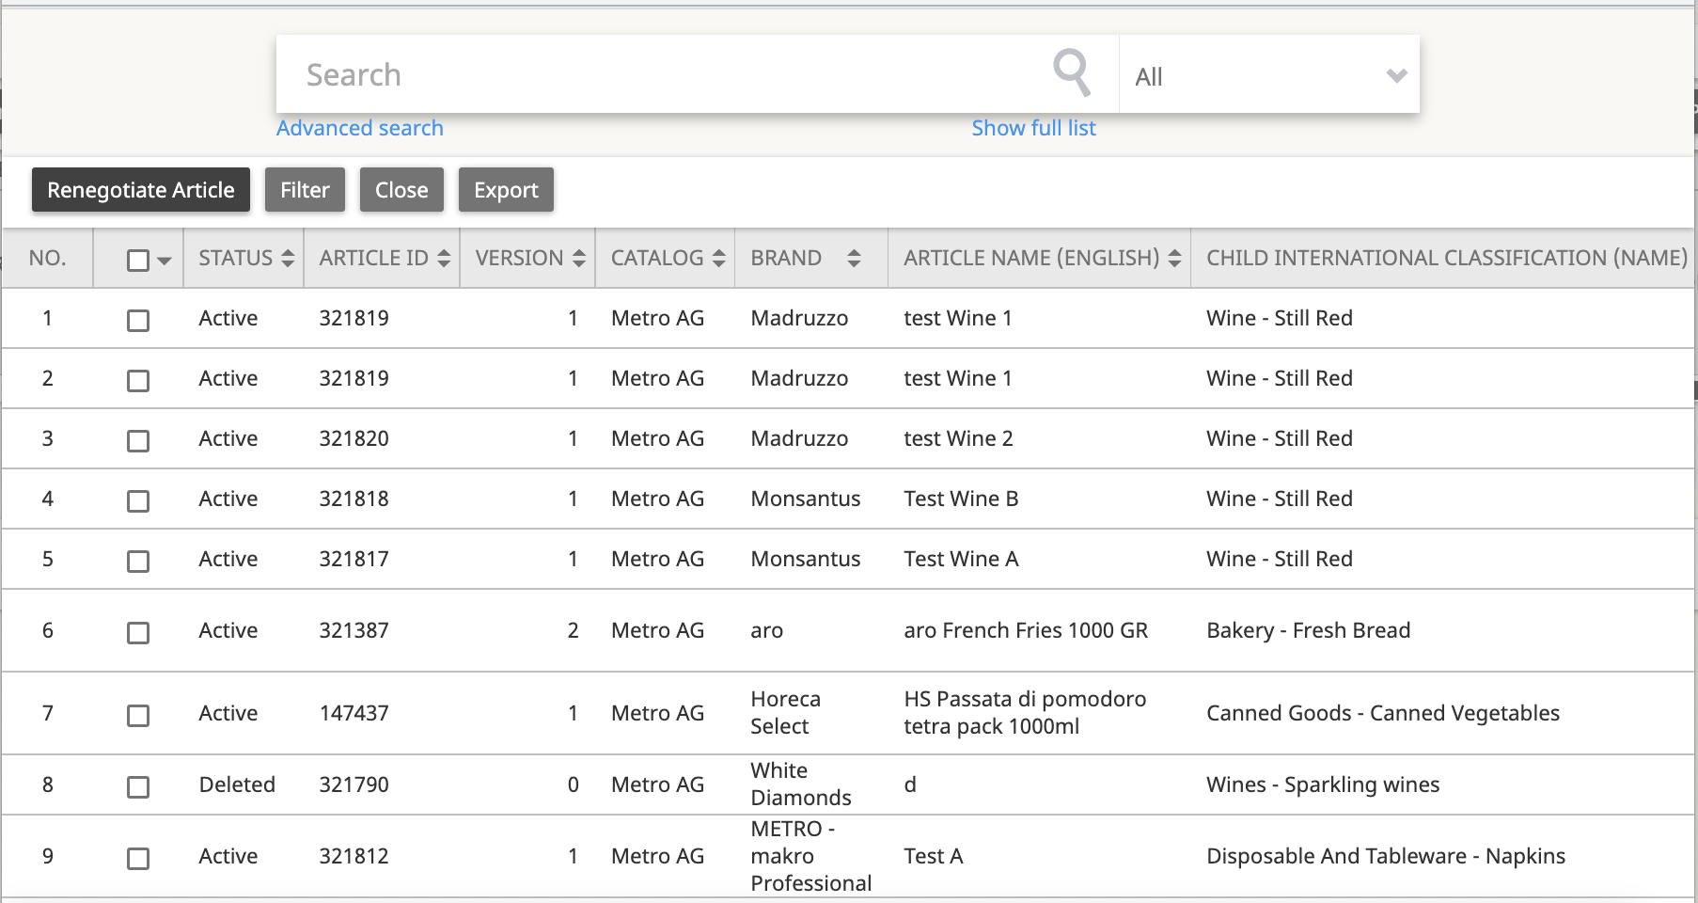
6. A) Renegotiate Article
The article has to be in ACTIVE status.

Slide 10
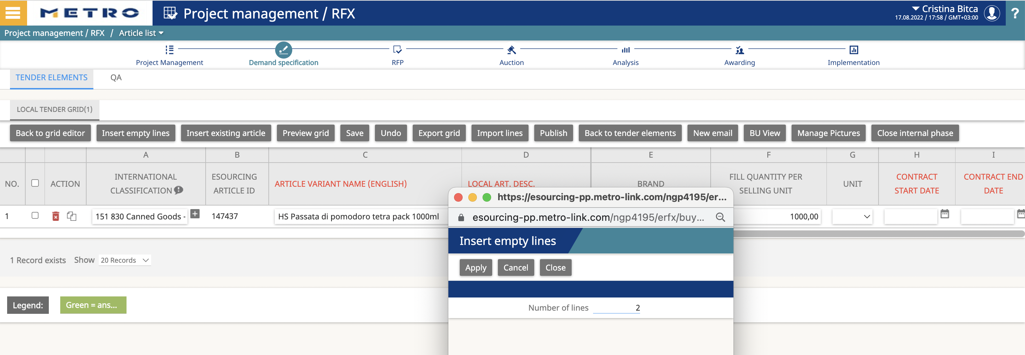
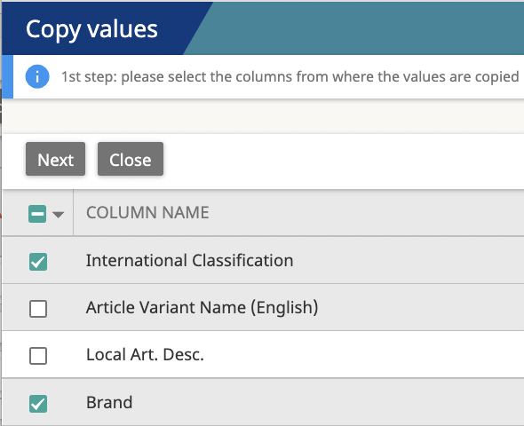
6.B) NEW ARTICLE
In Demand Specification -> Click on “Insert empty lines”
Enter the number of articles -example 2- you would like to create and click on “Apply”
Fill in your article information (column A to column K), mandatory fields are highlighted in red.
Article Variant Name (English)
Contract Start and End Date
Tender Quantity
Click on “Save”
“Copy Values”: you can copy the data from an article to another

Slide 11
7. Demand Specification
Before you proceed with RFP (or/and) Auction, klick on “Close internal phase” in DS
Please note that “Demand Specification” is mandatory for awarding

Slide 12
8.RFP
Create an RFP from Demand specification
Click on “Back to tender elements”
Click on “Transfer to RFP”
-> All article information will be transfered and a standard RFP table is created.

Slide 13
You will be guided to the RFP automatically
Click on “Set name” to change the name of you RFP
Click on “Previewer” to check the content of you RFP
Click on “Publish” to open the RFP for your suppliers
Attention: Before “Publish” - You can modify all lines in your RFP if you want / need.
To adapt (change/add/delete) the columns in the “grid editor” click icon and then push icon “Edit line items”

Slide 14
You can also create an RFP without using the functionality “Transfer to RFP”.
After RFP is published the following actions are possible :
You can close or extend your RFP to open access to supplier again when the deadline is reached.
Track & Trace project progress.
You can add supplier & project teams.
Send instant messages to buyer team and supplier circle in ‘Emails and Reminder’.
Analyze supplier answer via ‘View answer’.
Preview(Choose the role to see the grid either as a lead, supplier or starting bids).
View answer (answers from all supplier are displayed).
Phase report.
Audit trail.
Extend
View Answers
View Report
Preview
OPEN
Close
Documents

Slide 15
9.How to create RFP Grid from scratch? (Optional)
Click on RFP/New grid to create your request for Proposal/Quotation.
Select “Empty Grid“ or Simple RFP grid from the “Commodity“ grid template to create a grid where suppliers will enter their prices.
Then Click `Apply´- you can even name the grid.
Once you have created the RFP Grid, click on `Open´in order to create coloumns and rows – please contact us in such cases !
Create and name coloumns by clicking on `Add Columns´
Create article lines by clicking on `Edit line items´and then click on `Insert empty lines´
Click on Save
Pay attention to the type, layout type, preferences and hidden for roles.
In type display: supplier will be displayed which you entered
In type Answer: supplier will be asked to enter in formation
Set Quantity demand for articles
Set historic price (By default hidden from supplier)
Please note that prices will not appear automatically in awarding, in case rfp grid is created from scratch and not via transfer.

Slide 16
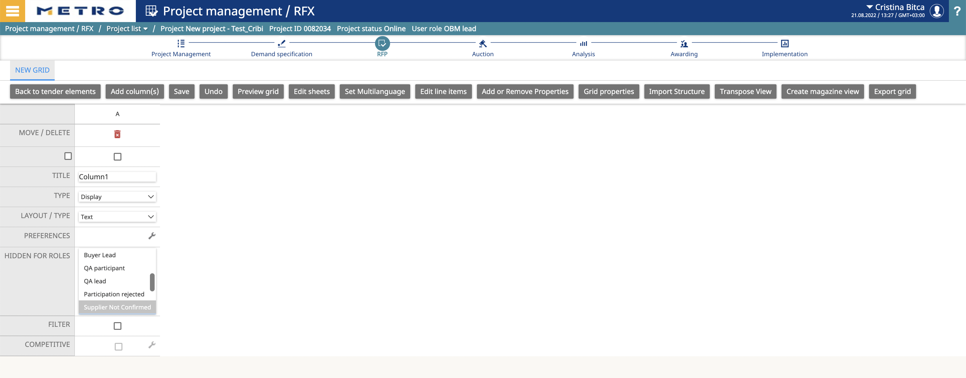
RFP GRID SETUP FROM SETUP (OPTIONAL)

Slide 17
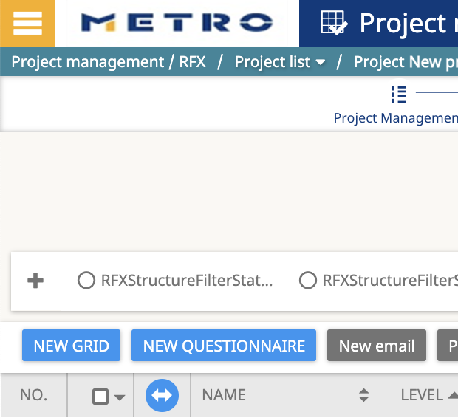
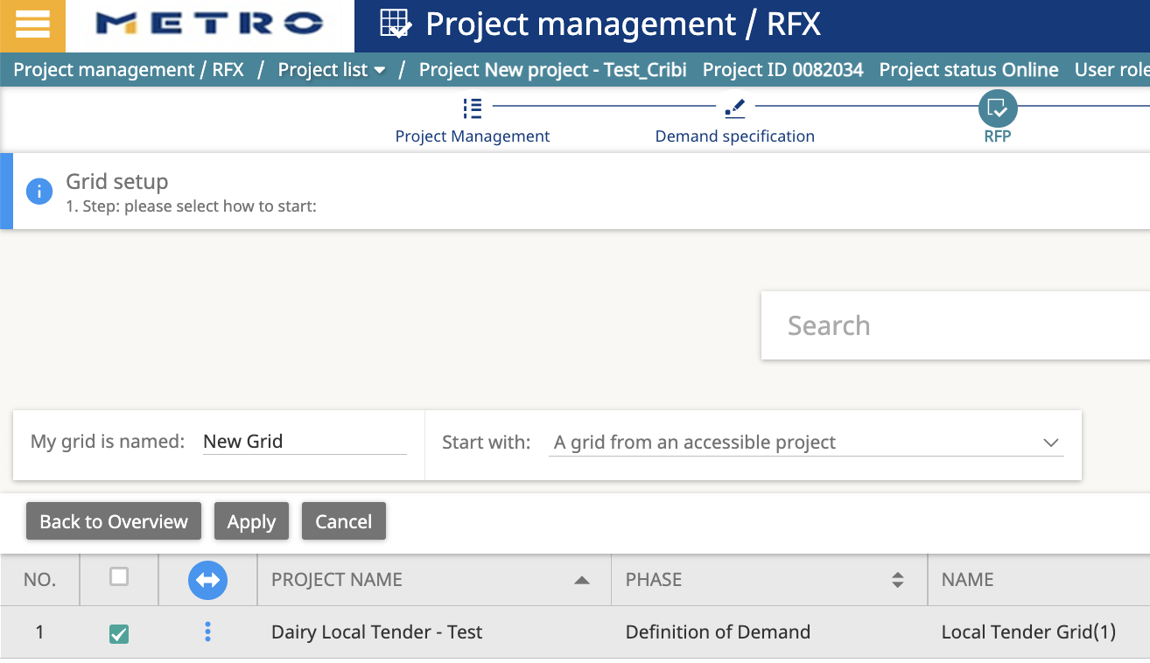
OR COPY RFP FROM ASSESIBLE PROJECT (OPTIONAL)
Click on RFP
Click on New grid
Select: A grid from an accessible project
Search for the old project by name
Select the RFP phase and click on Apply
You will have a new RFP In setup, with copied data from selected earlier project

Slide 18
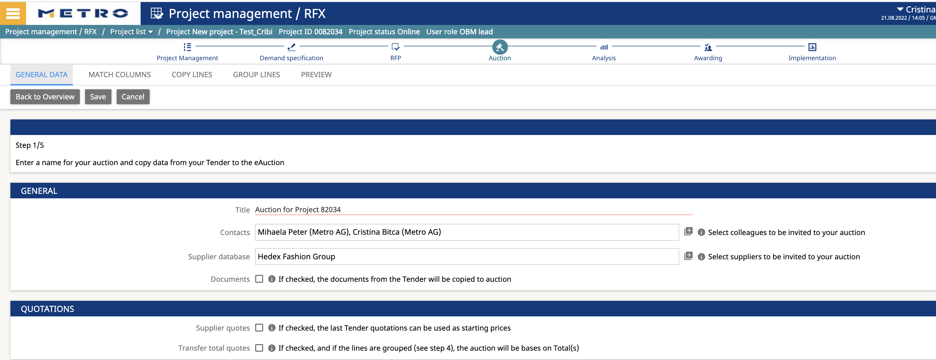
10. Auction
Transfer RFP to auction
Go to Auction
Click on “new”
Enter a name for your auction
Add or removes colleagues and suppliers
Tick the boxes in case you want to copy start prices and/or documents from your project to your auction
Click on “Save”

Slide 19
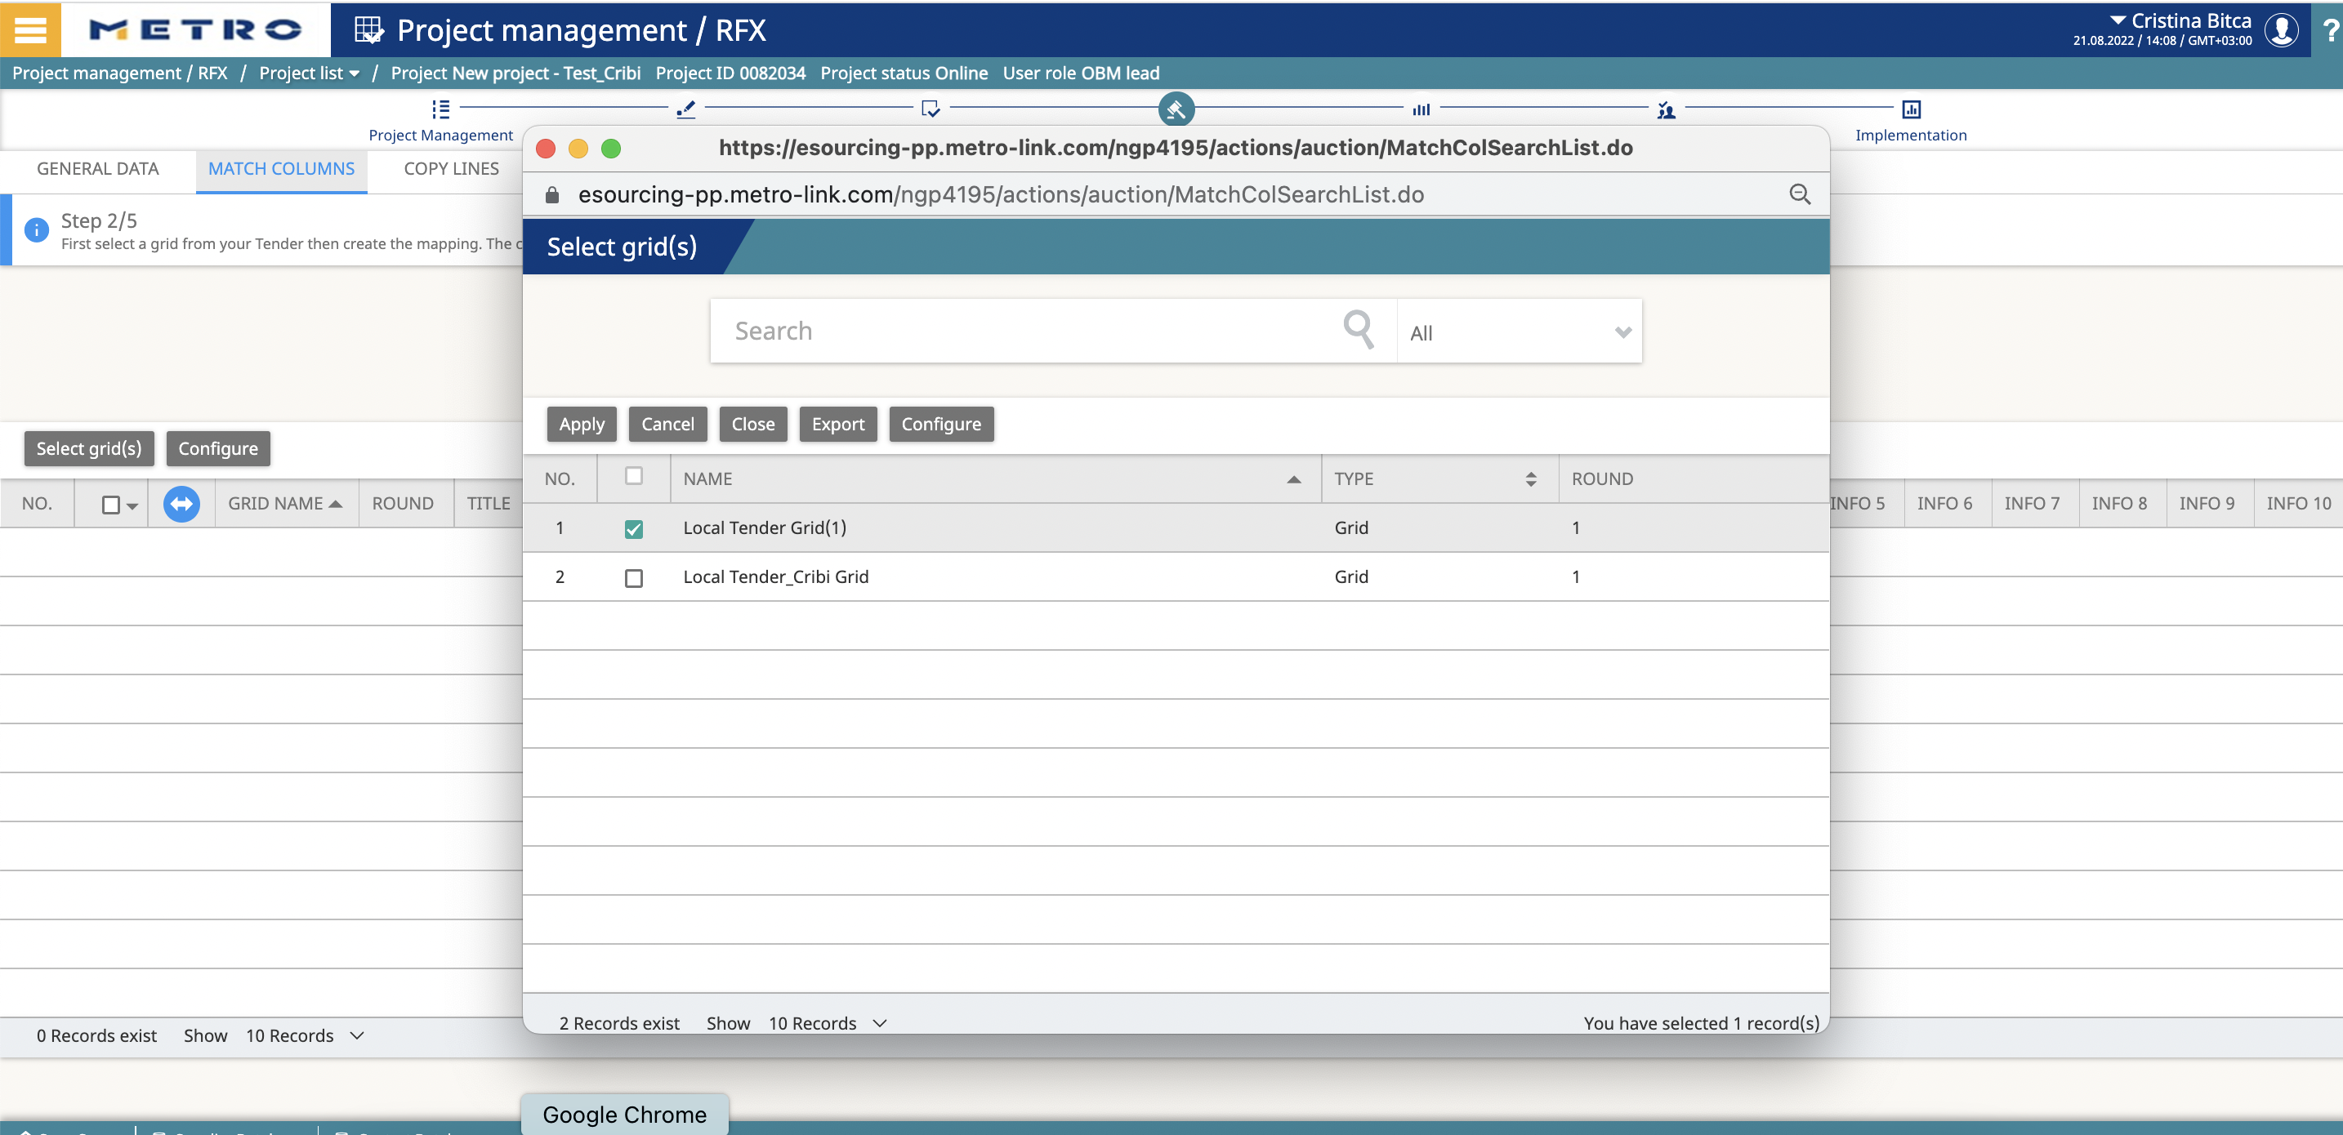
Auction Column
Go to “Match columns”
Click on “Select grid(s)” and select the RFP grid or the grid from Demand Specification
Click on “Apply”
Click on “Edit”

Slide 20
Match the RFP columns to the auction structure. Information from each column will be transferred to the auction – mandatory fields are highlighted in RED.
TITLE – QUANTITY- PRICE
Click on “Save”
SAVE

Slide 21
Auction : Copy Lines
Select articles for negotiation
Go to “Copy lines”
Select the articles you want to negotiate in your auction
Click on “Save”

Slide 22
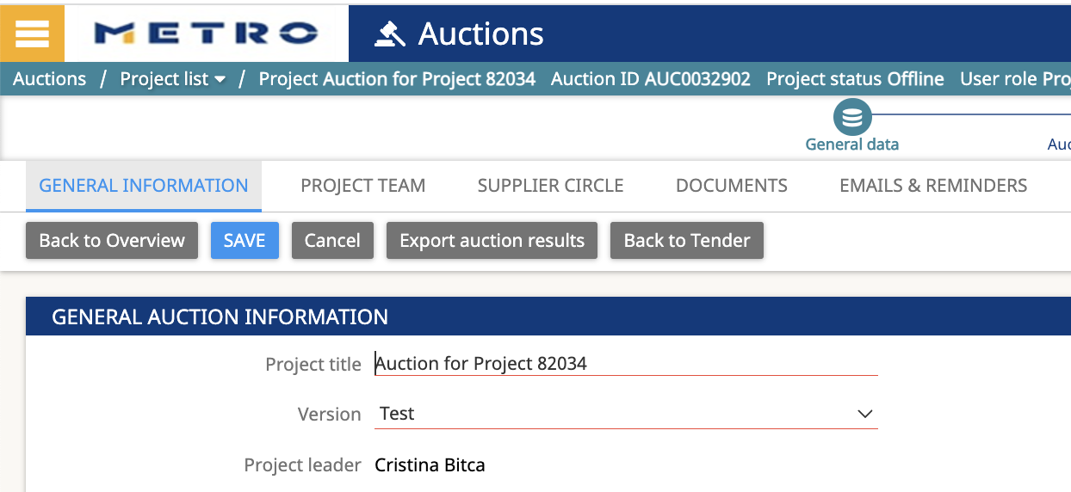
Finalize the Auction
Finalize transfer RFP to auction
Go to “Preview”
Check the data
Click on “Apply
You will be guided to Auction automatically
You can find your Auction later in the project
by click on “Open auction”
OPEN

Slide 23
AUCTION
You will open the auction from the project. You can now finalize your auction set up:
Below document type of auction listed are available via Offer Solution Service team:
English/Dynamic Auction
Japanese Auction
Dutch Auction
Define start date
Define competitive settings
Define overtime settings
Define bid box layout
You can as well change the auction structure, invite additional colleagues and/ or suppliers and upload more documents.
The “General Conditions” are mandatory for each auction and are uploaded under “General information”. Sourcing Support can provide a template for the “General Conditions”.

Slide 24
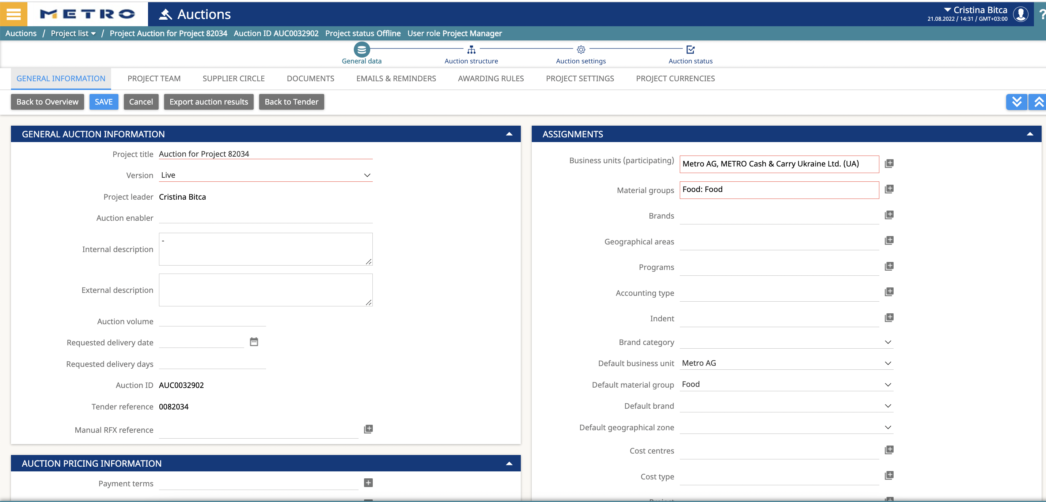
AUCTION is over – Bidding is closed
You want to award the project -> go back to tender level -> click on „Back to tender“

Slide 25
RFP (or/and) AUCTION is over – Bidding is closed
You want to award the project -> click on „AWARDING“
Two ways to conduct Awarding :
Apply Best Bid Rule - To select the single article for best price and quantity
Apply Total Best Bid Rule - To select all articles provided by single supplier

Slide 26
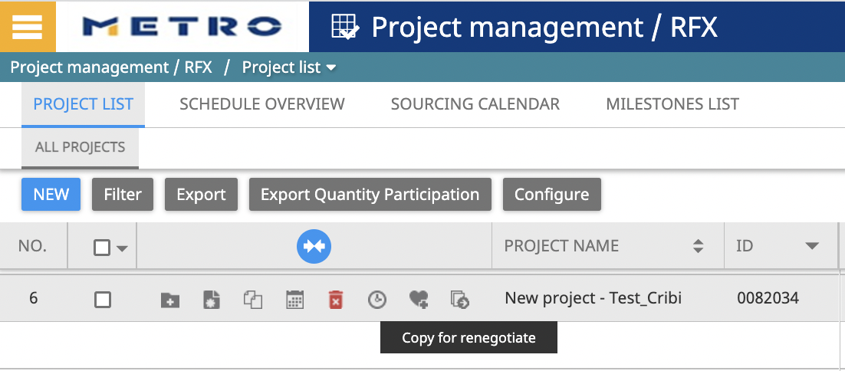
AWARDING
After the project was awarded you can use the Copy for renegotiate function in order to renegotiate the project

Slide 27
Contact :
If you need any support to use the eSourcing platform, please do not hesitate in contacting us.
Offer Solution Services Team
esourcing@sourcingsupport.de
Hotline: +49 211 969 4747
Mo. – Thu.: 08:00 to 18:00 CET
Fri.: 08:00 to 16:00 CET

