Slide 1
User Guide for eSourcing and METRO Link Plus Supplier and contact management

Slide 2
Introduction
As all other supplier facing applications, eSourcing (eS) is being integrated into METRO Link Plus (MLp) and will be accessible for your suppliers only via METRO Link Plus.
Target of the User Guide is to guide you through the E2E invitations process and potential scenarios which can appear during a project setup in eS.
The document will guide you through the needed steps in eS and MLp to ensure that all invited Suppliers for a project can access eS by using the Single Sign On functionality of MLp.

Slide 3
Procedural considerations
PROCESS STEPS
CONSIDERATIONS FOR PROJECT SETUP
1. Project Setup 2. Product requirements 3. Request for Price and Samples 4. Assessment and Supplier List 5. Supplier selection, awarding 6. Pack layout development 7. Pack layout approval 8. Production samples 9. Launch
Direct access to eS application is disabled and suppliers should access eS via MLp. Supplier Self Registration request from eSourcing is disabled.
New and not onboarded suppliers must register via MLp, already registered users can get eS assigned without registration. Registrations are project independent, suppliers need to register only once.
Please allow ~2 working days for a new supplier contact to register in MLp. Invitations expire in 5 days, after which they need to be resent.
New prospect supplier registrations must be approved by the sourcing experts via MLp.
As soon as the supplier and contact registrations in MLp are completed, then they can be added to the supplier circle of any project.
eSourcing project setup including supplier circle should be ideally completed at least 1 week prior to publishing. Publishing with incomplete supplier circle is not advised.
OSS supports you and your suppliers via:
eSourcing@sourcingsupport.de
Hotline: +49 211 969 4747
Mon. – Thu.: 08:00 to 18:00 CET
Fri.: 08:00 to 16:00 CET

Slide 4
Workflow for setting up eSourcing supplier circle
OSS/Buyer
OSS/Buyer
Company available in MLP?
OSS/Buyer
OSS/Buyer
Contact available in MLP?
Yes
OSS/Buyer
Creates project in eS and searches for supplier contacts
Checks if company available in MLp as listed supplier.
Yes
Checks and enables eS for the company if not yet done.
Checks if needed contact is registered in MLp.
Checks and enables eS for contact if it is missing in MLp.
No
No
Are all suppliers, contacts available in eS?
OSS/Buyer
OSS/Buyer
No
Checks if company available in MLp as prospect supplier.
Invites contact to register in MLp.
Yes
Company available in MLP?
OSS/Buyer
Supplier
Buyer
No
Invites company and contact to register in MLp.
Fills and submits the registration via MLp.
Receives notification from MLp, approves registration in MLp.
Yes
OSS/Buyer
Contact available in MLP?
No
OSS/Buyer
OSS/Buyer
Checks if needed contact is registered in MLp.
Informs the supplier admins to register the new contact.
Adds the new contact into the supplier circle in eS.
Yes
OSS/Buyer
Finanlizes the supplier circle in eS.

Slide 5
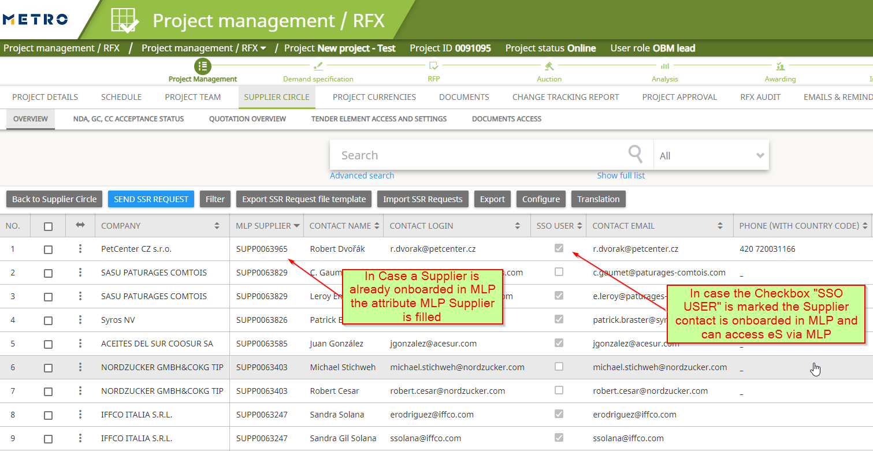
STEP 1: Search for suppliers or contacts in eSourcing
If the supplier is displayed in eSourcing with an MLp number (=supplier company is registered) AND the contact is marked with “yes” in the SSO column (=supplier contact is registered), then you can you can add it to the supplier circle.
If the supplier is not displayed OR displayed without an MLp number or without SSO, then the supplier needs to register or the eSourcing service needs to be assigned via MLp.

Slide 6
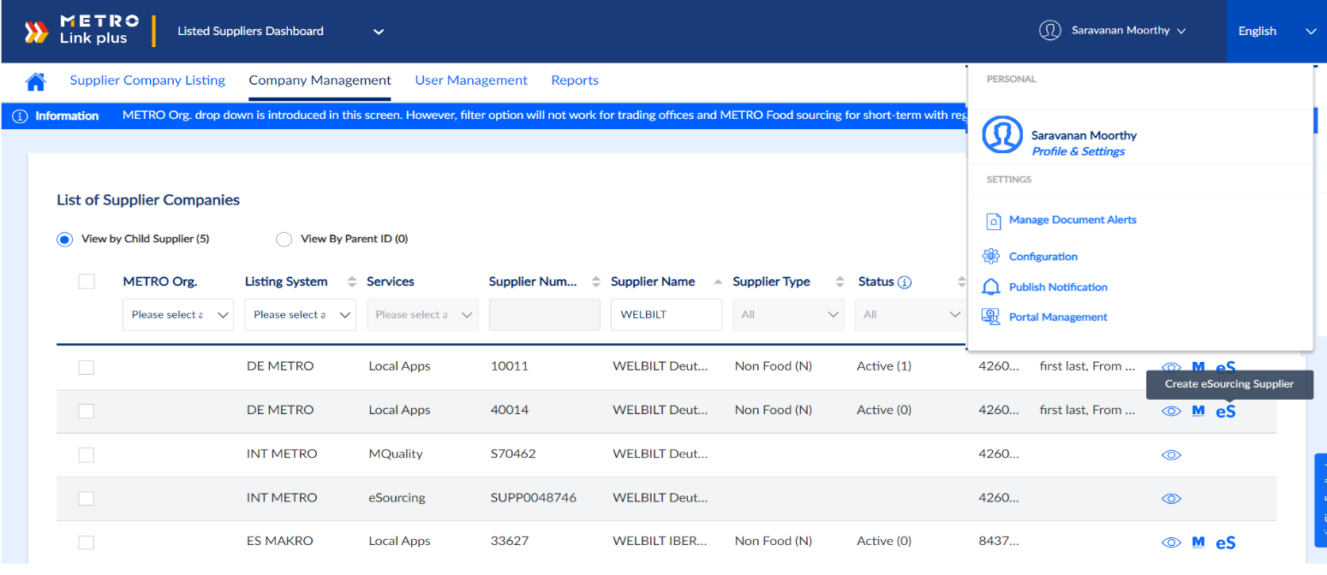
STEP 2: Search for available supplier companies
Below we describe how to search for available supplier companies in MLp, and how to create new company profiles for eSourcing.
Open Portal Management in Listed Supplier Dashboard.
Navigate to Company Management tab.
Select “View by Child Supplier” option.
Enter a supplier name and press enter.
Check the search results:
If the supplier cannot be found in the list, then please continue with slide Step 5.
If the supplier is found and eSourcing is displayed in the services column, then the supplier company profile has been already created. Please continue on the next slide, Step 3.
1
2
3
4
1
5
If the supplier is found but eSourcing is not displayed in the services column, then the supplier company must be created for eSourcing as described below.
6. Please check the supplier profiles in the list, and take any of available profiles, then click on the on eSourcing icon.
Next, you need to check if the needed contact(s) are already invited or have eSourcing assigned, as described on the next slide.

Slide 7
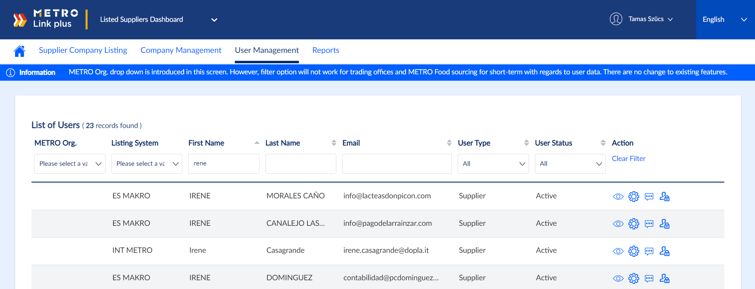
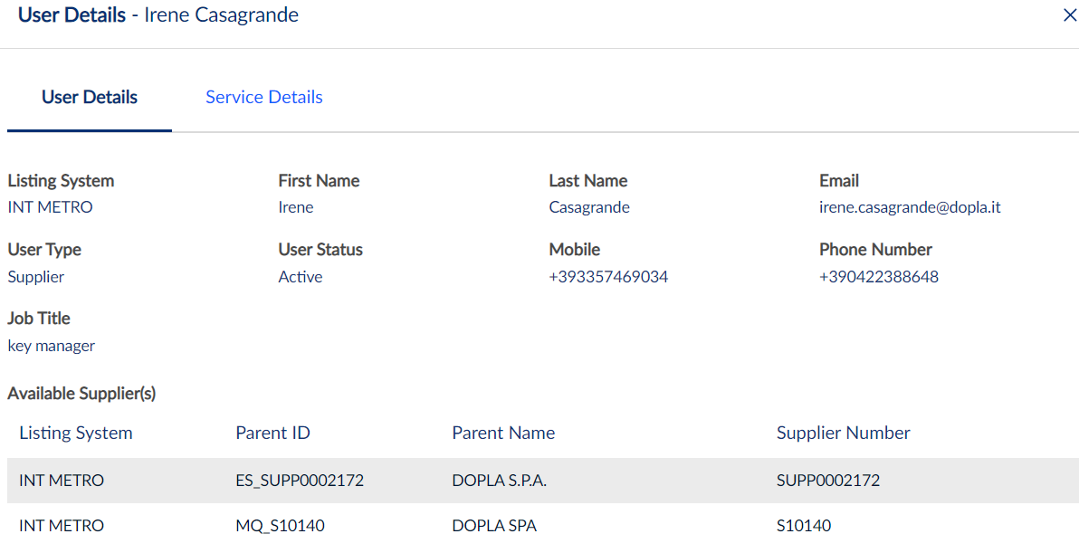
STEP 3: Search for available eSourcing supplier contacts
Below we describe how to search for available supplier contacts in MLp, and how to check whether they have eSourcing service assigned.
1
Open Portal Management in Listed Supplier Dashboard.
Navigate to User management tab.
Enter a contact name or email address and press enter, then check the results:
If the contact doesn’t appear then you need to invite the user, as described on the next slide, Step 4a.
If the contact appears then you need to check if eSouricng is assigned, as described below.
Click on view icon to open the user details.
In the user details window, you can check if eSourcing is assigned to the user.
If it is assigned to the user, then the contact is available in eSourcing already, ready to be added to supplier circle.
If it is not assigned to the user, then you need to do that as described on side Step 4b.
2
3
4
5

Slide 8
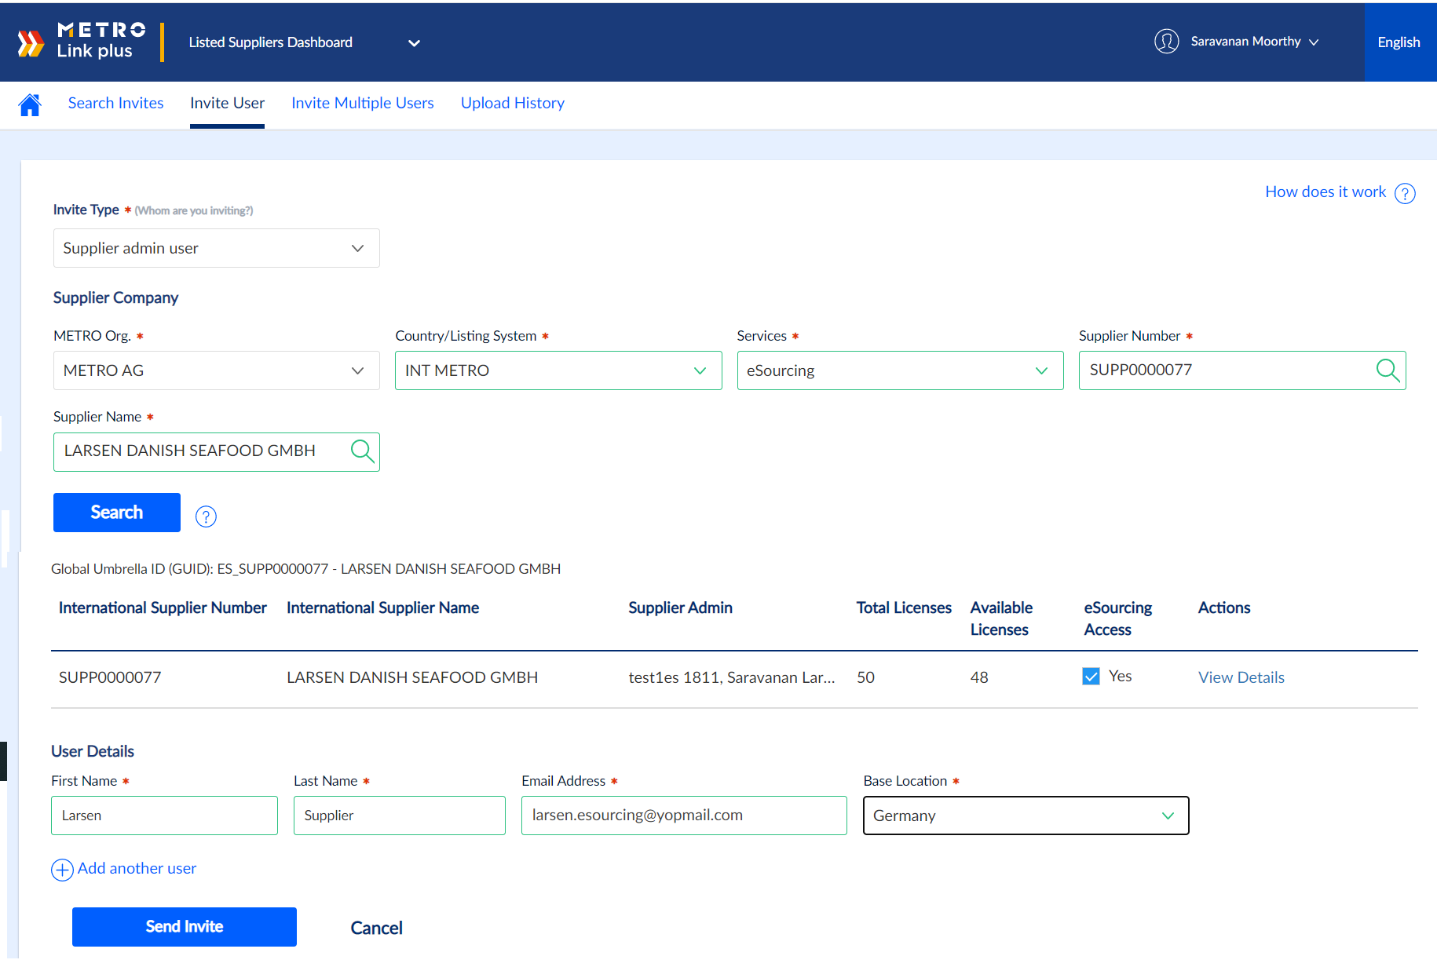
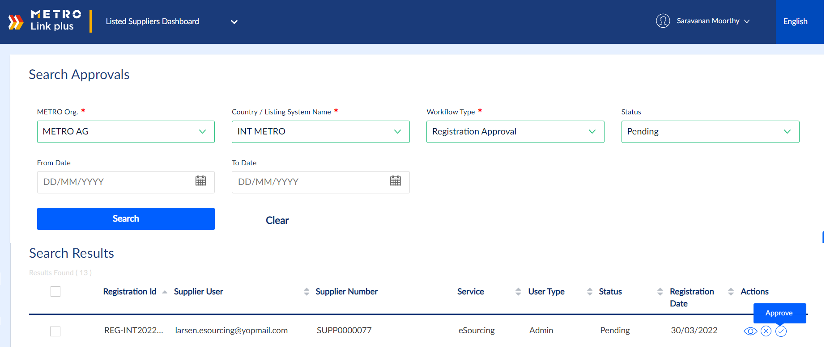
STEP 4a: Inviting new contact for an existing eSourcing supplier
Below we describe how to invite a new contact for an existing eSourcing supplier company via MLp, and how to approve its registration.
1
Navigate to the Listed Supplier Dashboard.
Click Supplier Onboarding >> Invite User (from Home icon)
Select Invite Type as “Supplier admin user”, METRO Org. as “METRO AG”, Services as “eSourcing”
Search for supplier Name or eSourcing supplier number
Provide User details (First Name, Last Name, Email Address and Base Location)
Send the Invite to Supplier Admin by clicking on “Send Invite” button.
After this the contact will have 5 days to register before the invitation expires. Once the contact registers, then the inviting METRO employee receives an email notification to approve the registration.
2
3
4
5
6
7
8
Navigate to Search Approval Screen.
Select METRO Org. as “METRO AG”, status as “Pending” and search for the request
MLP perform supplier registration search and provide supplier admin
Approve the pending the registration using “Approve” button. As a result, the contact gets access to eSourcing, and can be added to the supplier circle in eSourcing.
10

Slide 9
STEP 4b: Assigning eSourcing service to a registered user
Below we describe how to assign eSourcing service to contacts who are already registered – i.e. using other services like MQ, SCOT, CustomerLens, etc. – in MLp.
1
Navigate Listed Supplier Dashboard
Go to Portal Management and select User Management tab
Select for the Supplier user using email address
Select Wheel icon for Service assignment
2
3
4
Navigate to eSourcing Supplier tab
Search for the eSourcing Supplier
Click on Add Supplier
After this, the contact gets access to eSourcing and can be added to the supplier circle.
5
7
6

Slide 10
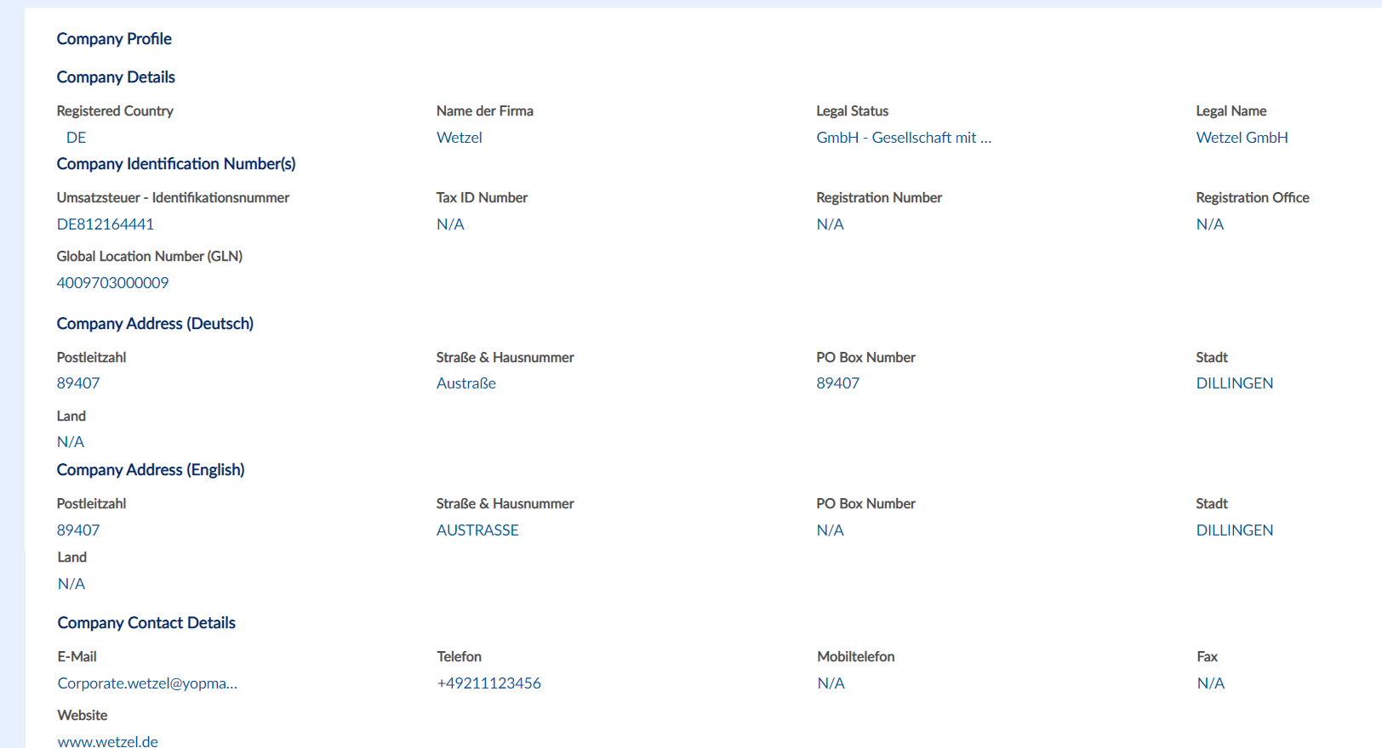
STEP 5: Search for available prospect supplier companies
Below we describe how to search for prospect supplier companies in MLp, who do not have a contract with METRO.
1
Open Navigate to the Prospect Supplier Dashboard.
Navigate to Portal Management and select Prospective Supplier Company Management tab
Enter a supplier name and press enter to search for:
If the company doesn’t appear in the list, then you can invite a new contact to register the company, as described on slide Step 7.
If the company appears then you can check the details and supplier contacts if you select the window.
On the next slide we describe how to check if the prospect suppliers’ contact has access to eSourcing.
2
3
2
4

Slide 11
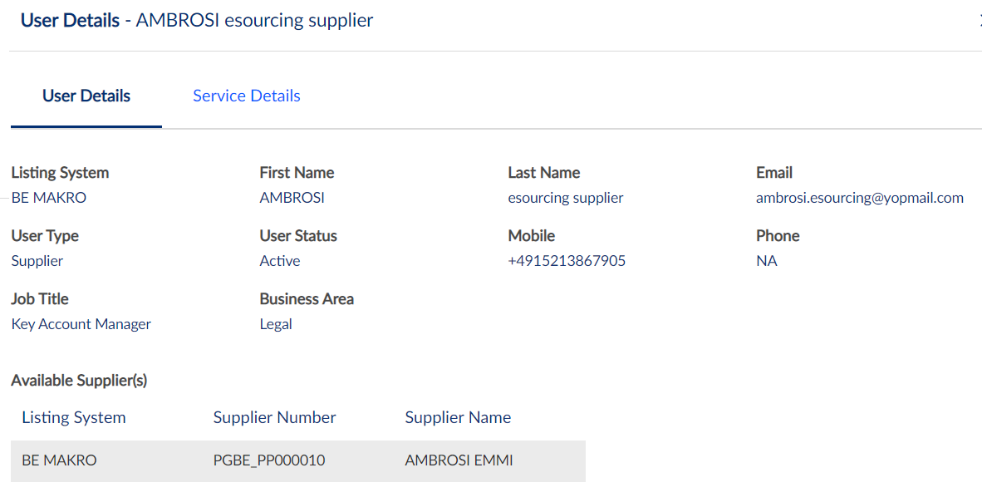
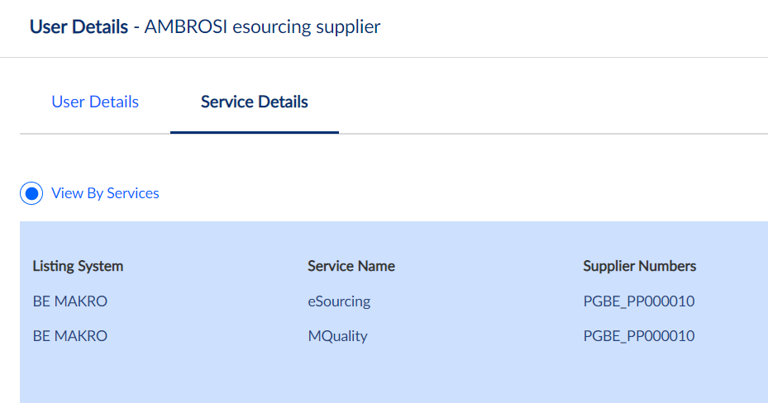
STEP 6: Search for available prospect supplier contacts in MLp
Below we describe how to search for contacts of prospect supplier companies in MLp, who do not have a contract with METRO.
1
Navigate to Prospective Supplier Dashboard
Navigate to Portal Management and click on Prospective Supplier Company Management
Enter a contact name or email address and press enter, then check the results:
If the contact does not appear in the list, then it needs to be invited. Only existing prospect supplier administrators can invite new users to their own companies. Please contact them to invite additional contacts into MLp. After a new contact registers, it automatically appears in eSourcing, and you can add it to your project.
If the contact appears in the list, then you can check if eSourcing is assigned to the user as described below.
Click on the view details icon.
In the service details tab, you can check if eSourcing is not assigned to the user:
If eSourcing is assigned to the user, then the contact is available in eSourcing already, ready to be added to the supplier circle.
If eSourcing is assigned to the user, then please contact eSourcing@sourcingsupport.de for time being.
2
3
4
5

Slide 12
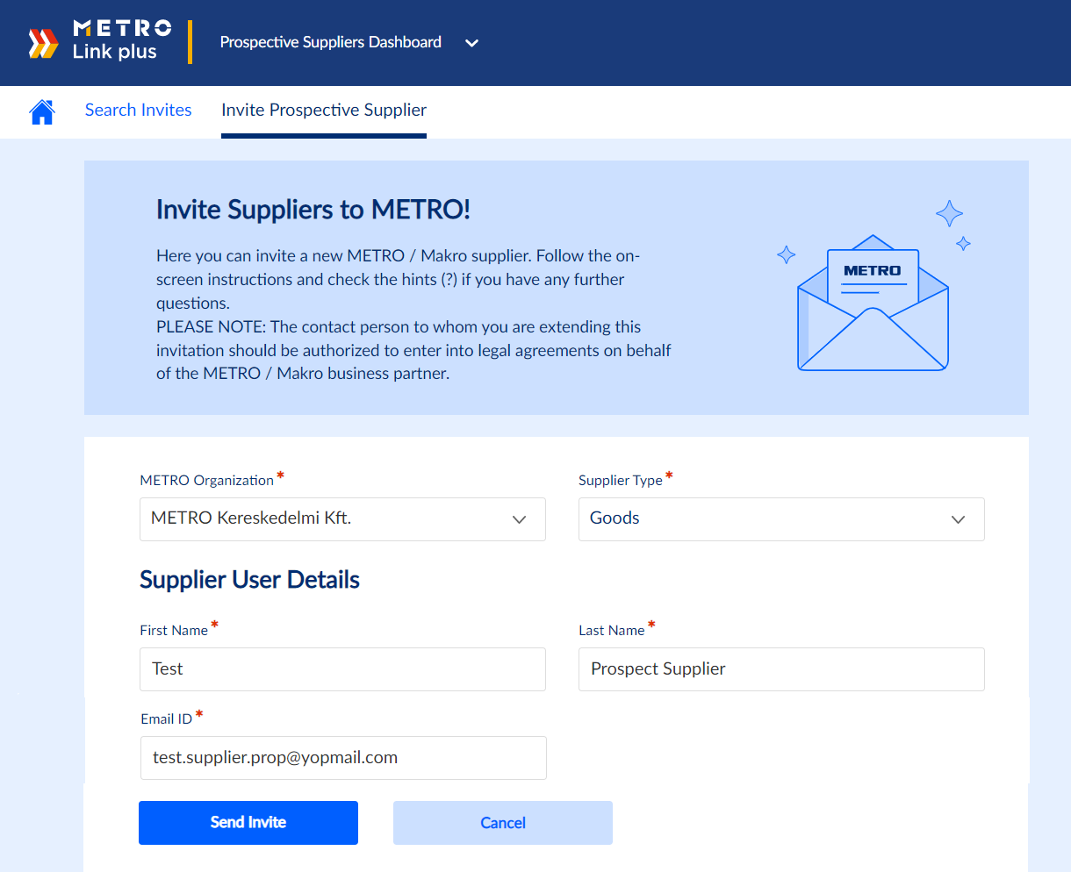
STEP 7: Inviting a new prospect supplier and contact via MLp
Below we describe how to invite a new contact and a new prospect company into MLp and eSourcing.
1
Navigate to the Prospect Supplier Dashboard.
Go to Invite Prospective User
Select METRO Org. and Supplier Type
Provide User details (First Name, Last Name, Email ID)
Send the Invite to Supplier Admin by clicking on “Send Invite” button
2
3
You can invite only one Supplier user to register their company details for prospective Suppliers. Once the admin is registered, the admin can invite further users from their company
After this the contact will have 5 days to register before the invitation expires. Once the contact registers, then you receive an email notification.
4
5
6
Once registered, the supplier registration should appear with status “Awaiting Approval”
Click on View details to approve the registration as described on the next slide.
7

Slide 13
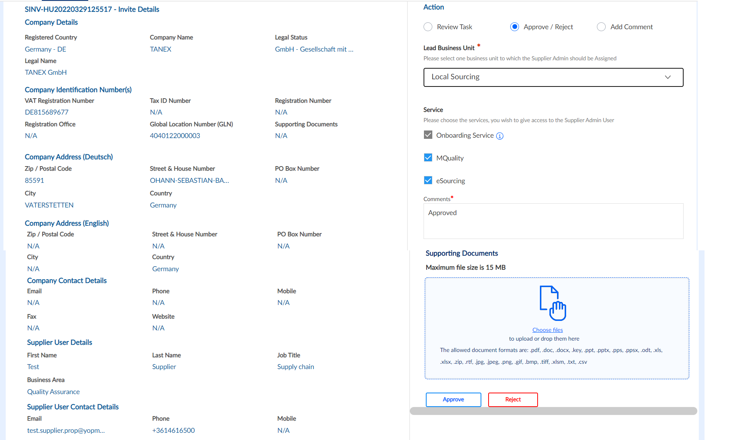
STEP 8: Approving a new supplier and user to an eSourcing supplier via MLp
Below we describe how to approve a new contact and a new prospect company into MLp and eSourcing.
1
Please always verify the supplier company information provided by Supplier.
Select the Action as “Approve/Reject”
Provide the Lead Business Unit
Select MQuality, eSourcing and provide a comment, e.g. “Approved”
Approve the registration using “Approve” button.
After this, the contact gets access to eSourcing and can be added to the supplier circle.
2
3
4

