Slide 1
Mass Maintenance

Slide 2
Template for Mass Maintenance
Store Hierarchy Node ID 5 6 7 8 9 | UK Marketplace UK Stores Ireland Online Ireland Stores UK Online
Notes:
DT is Product going up or down

Slide 3
Template for Mass Maintenance
Vendor Number
Tier Number and IsTieredPrice : Fill with 0s
Notes:
DT is Product going up or down

Slide 4
Template for Mass Maintenance
Price Lock Reason
Notes:
DT is Product going up or down

Slide 5
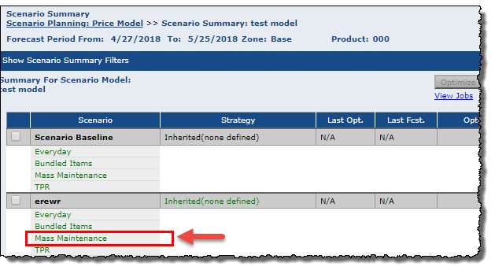
Mass Maintenance - Options
Mass maintenance can be accessed in Pricing or Scenario Planning
In the production Scenario or in a price model
Opens Pricing Summary

Slide 6
Create Pricing Session
Notes:
DT is Product going up or down

Slide 7
Create Pricing Session
Notes:
DT is Product going up or down

Slide 8
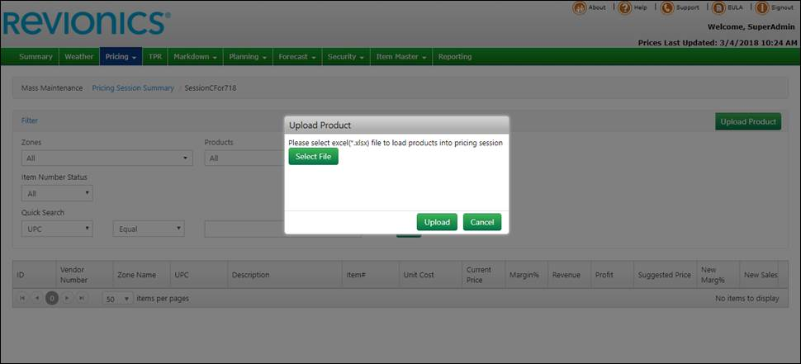
Mass Maintenance – Upload Process
Select the file
And upload

Slide 9
Upload and Submit Data File
Notes:
DT is Product going up or down

Slide 10
Review Status
Pricing Session Statuses: Created- Planning-Complete
Notes:
DT is Product going up or down

Slide 11
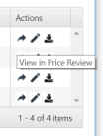
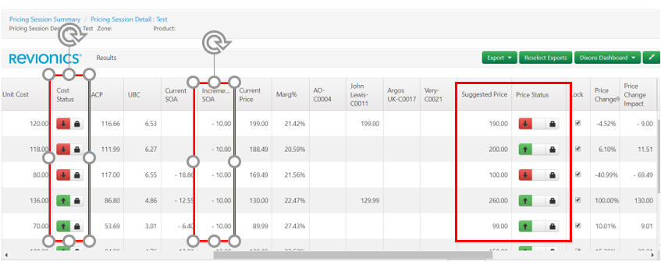
Review Changes in Price Review
Planning /Active / Complete
Notes:
DT is Product going up or down

Slide 12
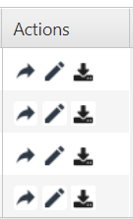
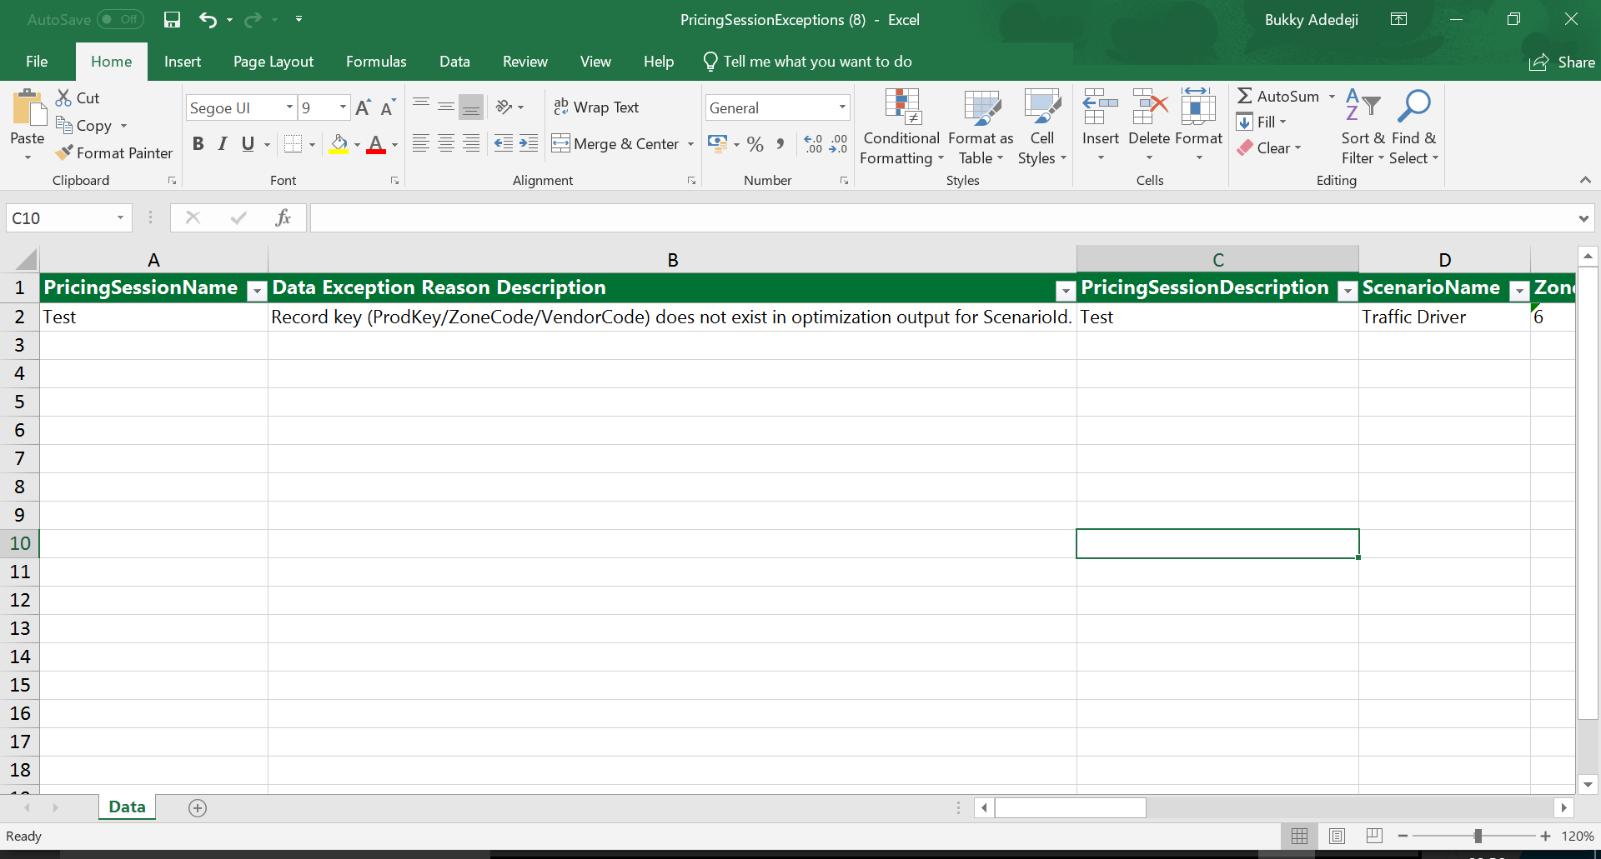
Review Exceptions
Notes:
DT is Product going up or down

Slide 13
Review Exceptions
Items that failed to load successfully are shown in the exception report
Notes:
DT is Product going up or down

