Slide 1
Presentation MDW Sourcing solution

Slide 2
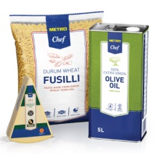
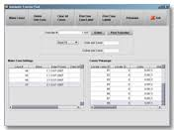
Benefits
Market Price
Final negotiated price
Commitment QTY
GTIN
……..
eSourcing
Own Brand Articles of all countries and Corporate are available in CCR MDW
MDW CCR
MMS-PL/CZ/CN,….
Local Article ID
Local Article Desc.
Buying Price
Selling price
………
MDW PL
MDW CZ
MDW CN

Slide 3
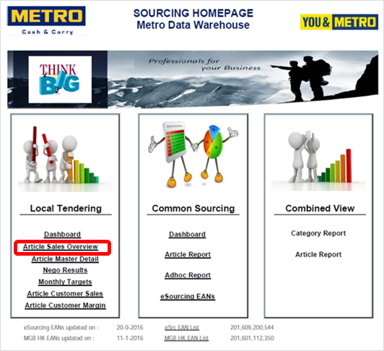
Following data are available
Brand
Own Brand
Non Brand
Common Sourcing
Local Tendering

Slide 4
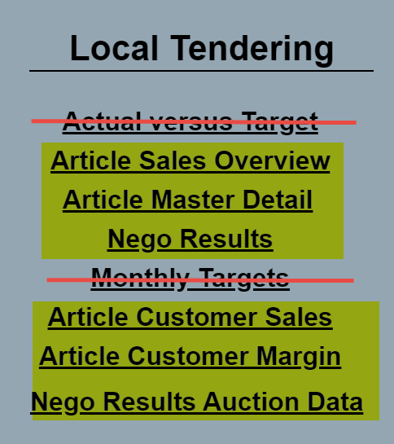
Overview reports

Slide 5
Benefits
Country is able to create one common view about the performance of all different article types

Slide 6
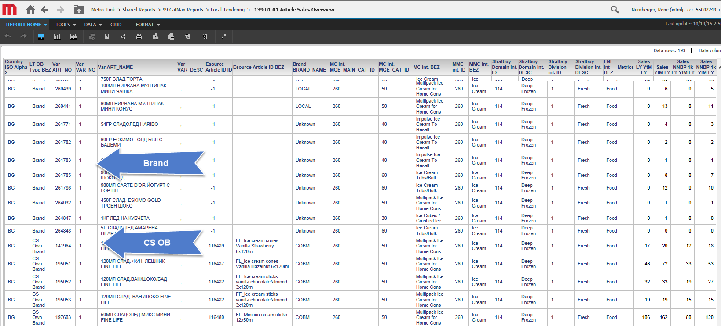
Benefits

Slide 7
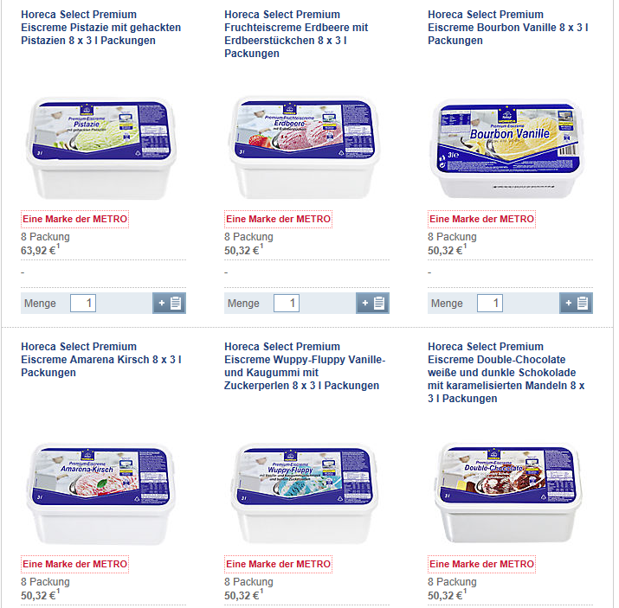
Local Tender Project Ice Cream (MCC DE)

Slide 8
Benefits
MDW CCR

Slide 9
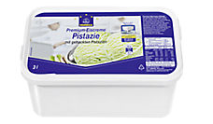
Benefits
I need to know
potential suppliers who
can produce my Own Brand
Horeca ice
MDW CCR

Slide 10
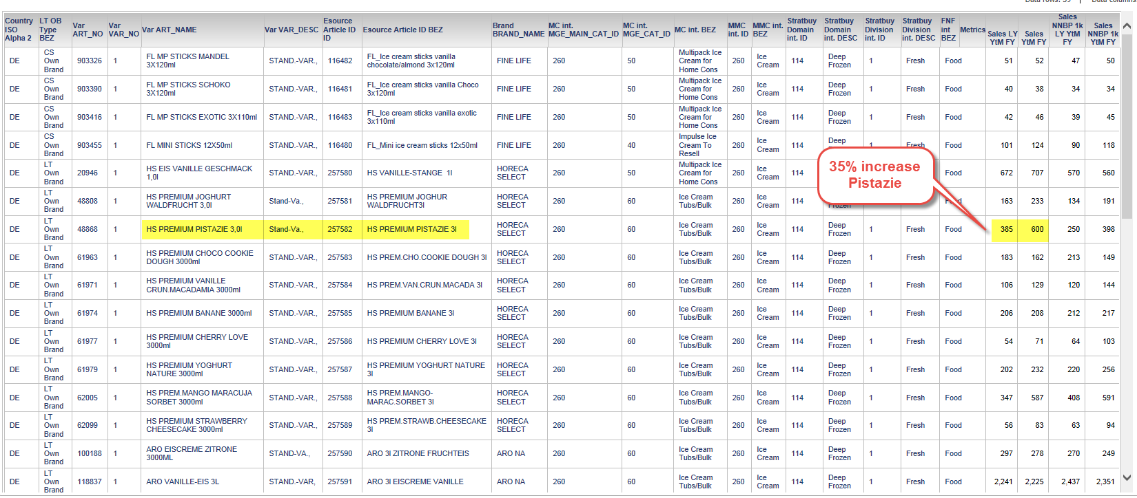
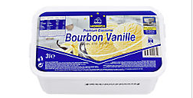
Benefits
MDW CCR
Top Seller article
Vanilla

Slide 11
Benefits
For Common Sourcing the sales over all countries can be checked under 1 eS Article ID
Sales per Country

Slide 12
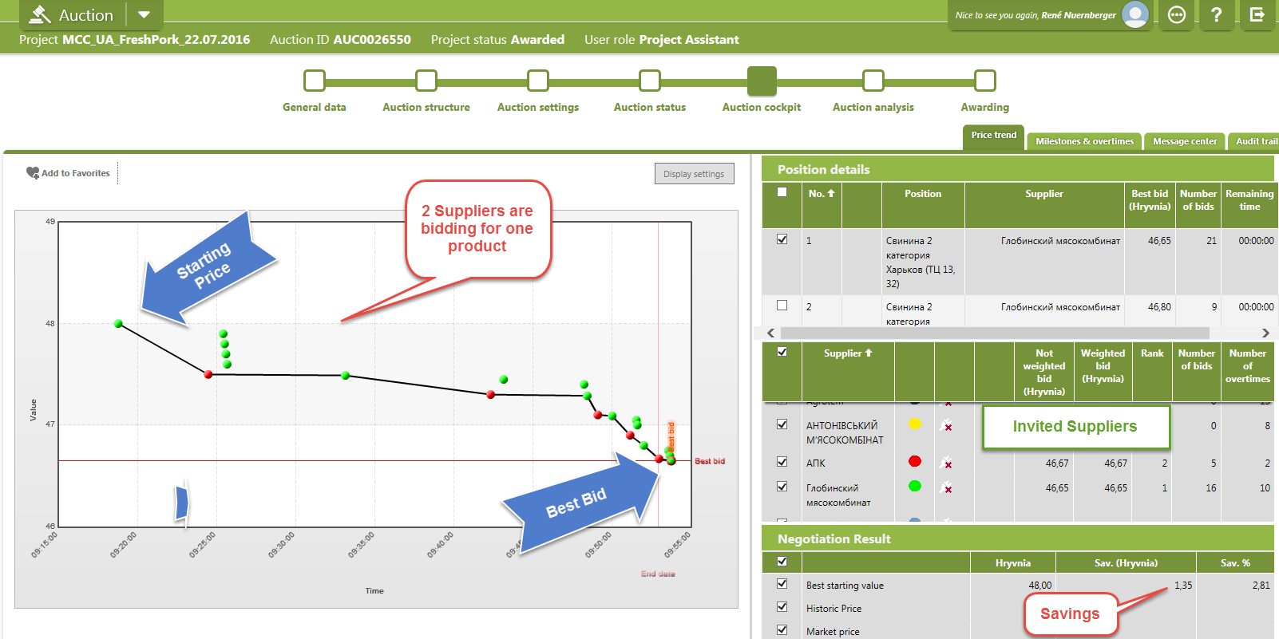
Benefits

Slide 13
Benefits
MDW CCR
Negotiated buying price of 4,290 € for ice cream pistachio based on a Quantity of 10.000 PCs

Slide 14
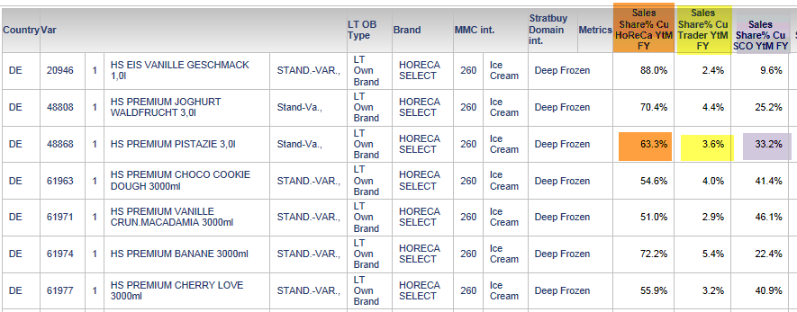
Benefits

Slide 15
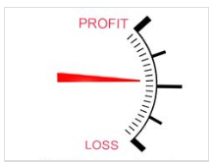
Benefits
Margin

Slide 16
 | private_label_cd | common_source_ind
CS Ownbrand | 1 | 1
Local Ownbrand | 1 | 0
CS Brand | 0 | 1
Brand | 0 | 0
Local Tendering Own Brand
Other Local Own Brand
Brand
Local Tendering Non Brand

Slide 17
Report Overview

Slide 18
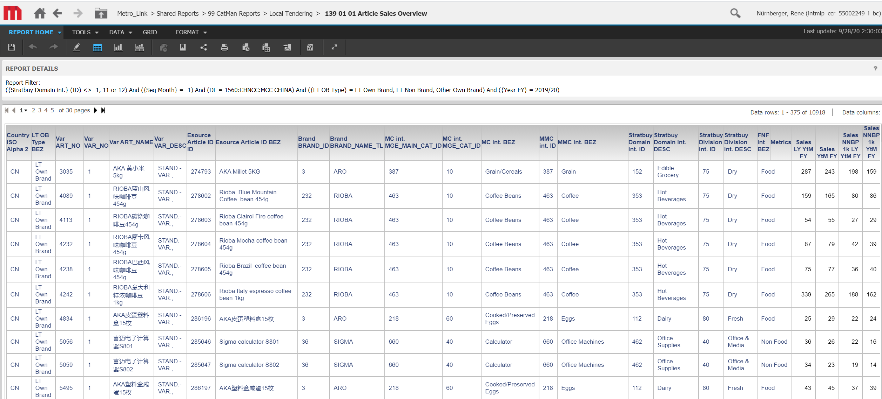
Article Sales Overview

Slide 19
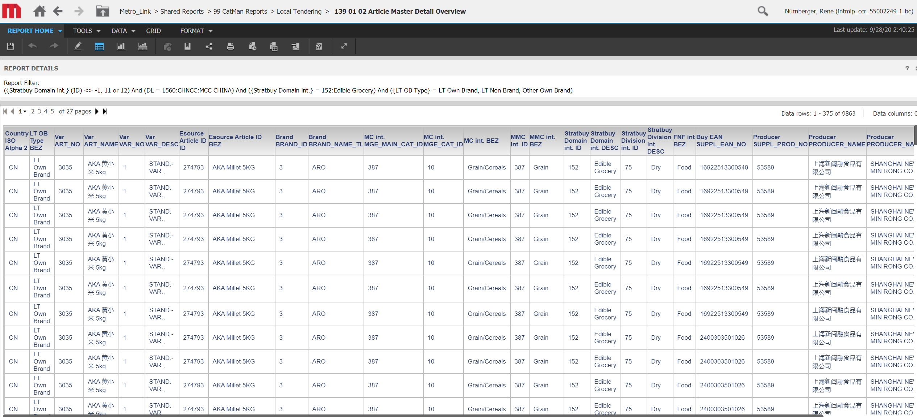
Article Master Detail overview

Slide 20
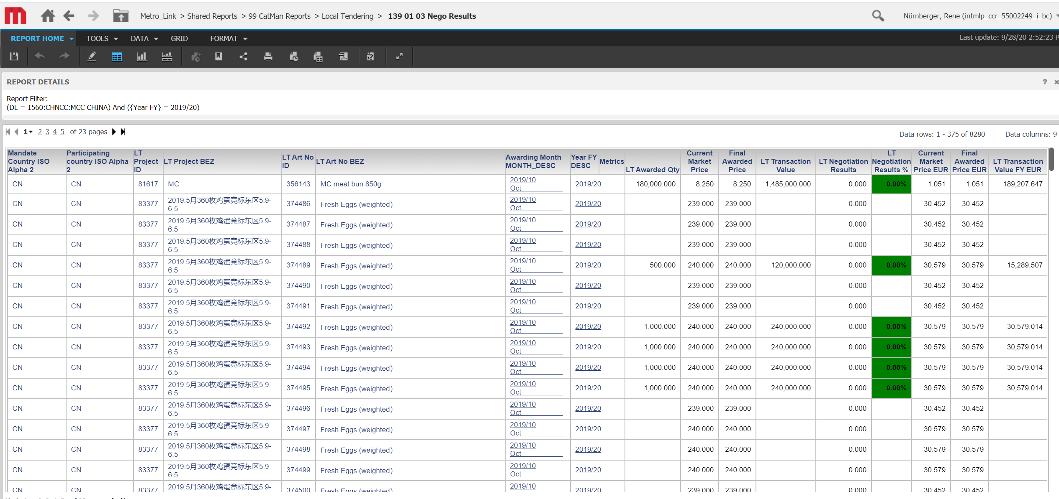
Nego results

Slide 21
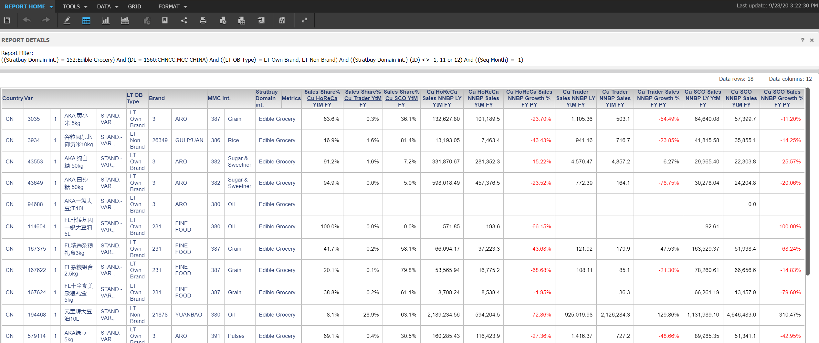
Article Customer Sales

Slide 22
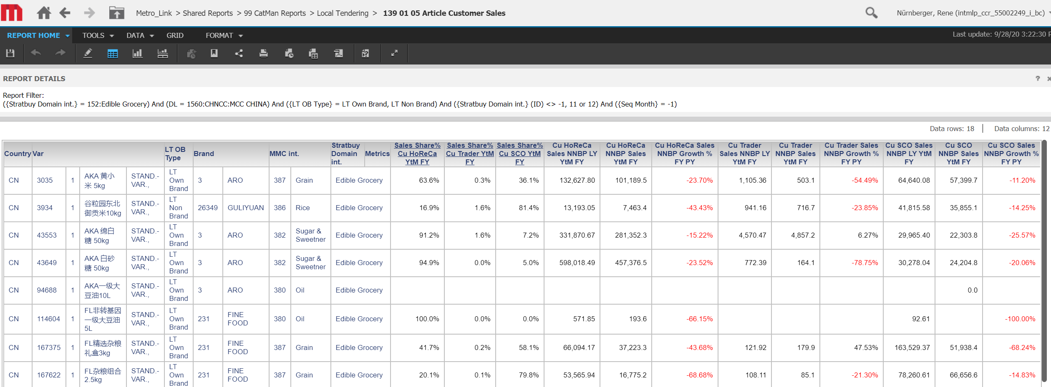
Article Customer Sales

Slide 23
Article Customer Margin

Slide 24
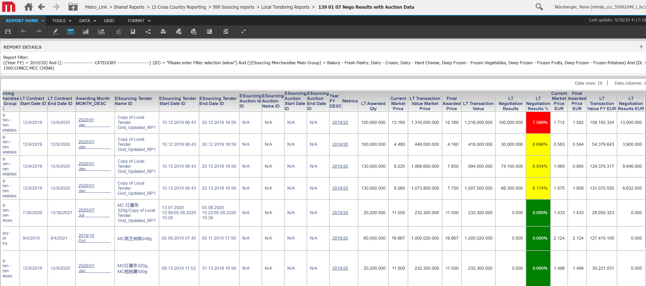
Nego Results with Auction data

