Slide 1
Supplier self registration process – gnfr
Düsseldorf
November 2020
Offer Solution Services Team:
Email: esourcing@sourcingsupport.de
Telefon +49 211 969 4747

Slide 2
Your invitation to register - login
You, as a supplier, have been selected as a potential supplier for METRO Group and invited to register for the eSourcing Portal.
In order to fill in the self registration form, you will be receiving two emails via the system: one with your password and another one with your username together with the link of the self registration form.
Please follow the instructions in the email and log in.
Notes:
Name und Email retuschieren!

Slide 3
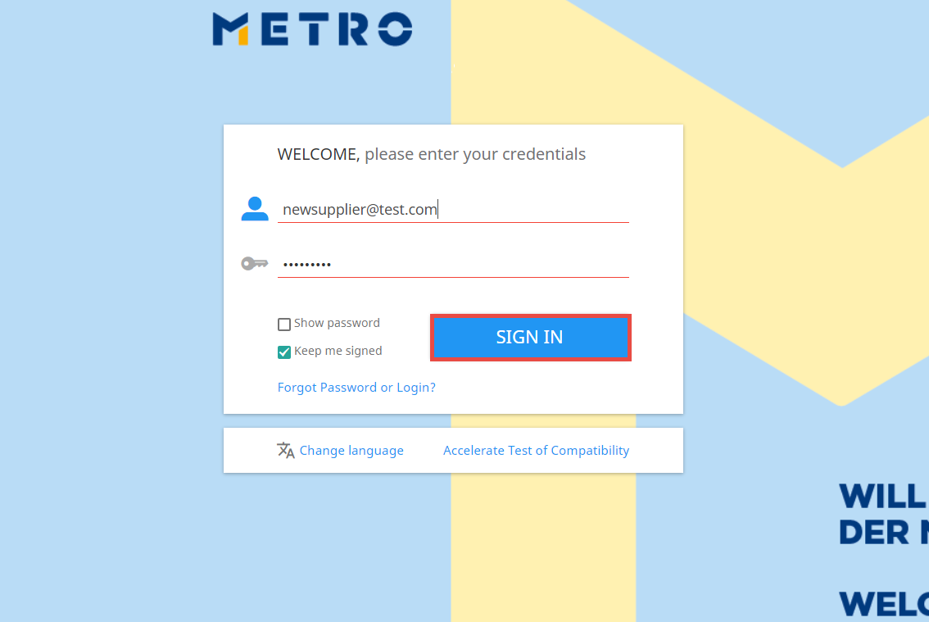
first e-sourcing login - https://esourcing.metro-link.com
Enter the user name and temporary password via two emails you receive from the system.
Click on SIGN IN to proceed with the next step.
Notes:
Name und Email retuschieren!

Slide 4
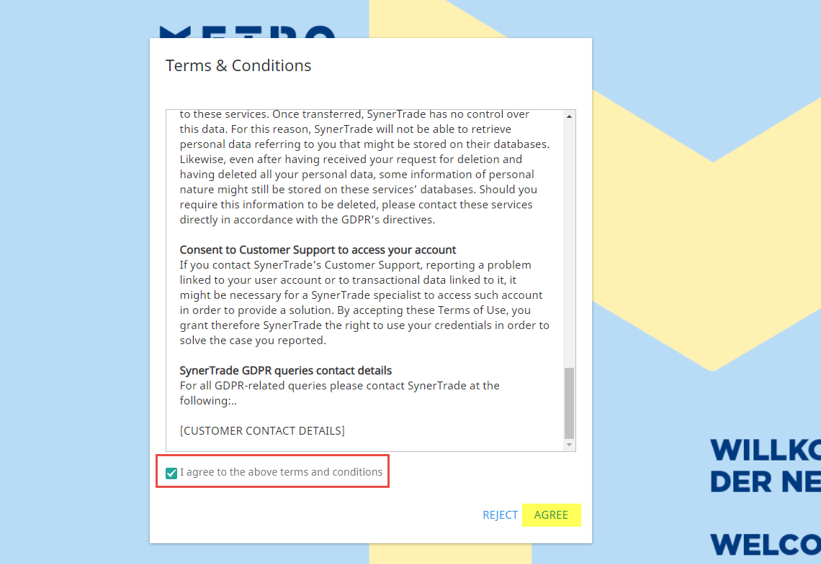
Terms & conditions
Scroll down and accept terms and conditions by clicking on AGREE.
You can now proceed with the registration.

Slide 5
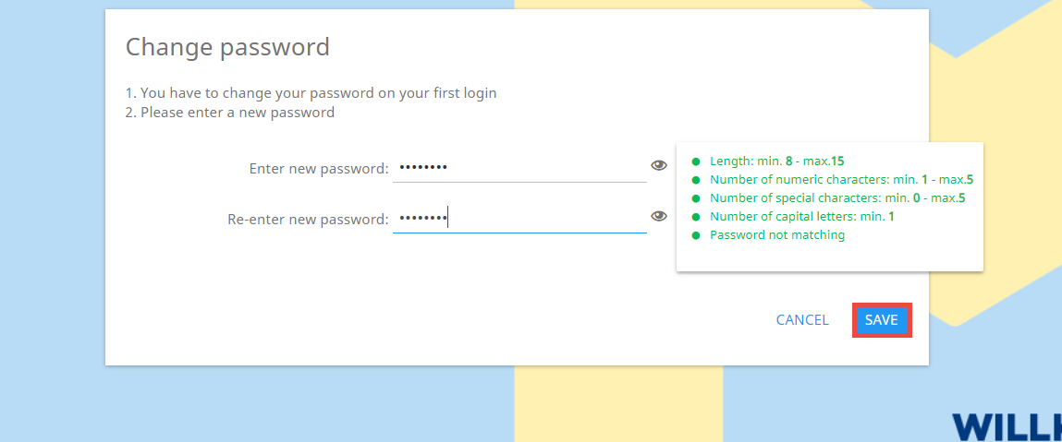
Change password
On your first login, you will be asked to change your temporary password that you received via the system.
The new password needs to meet the security requirements.
Enter the new password once again and click on SAVE.

Slide 6
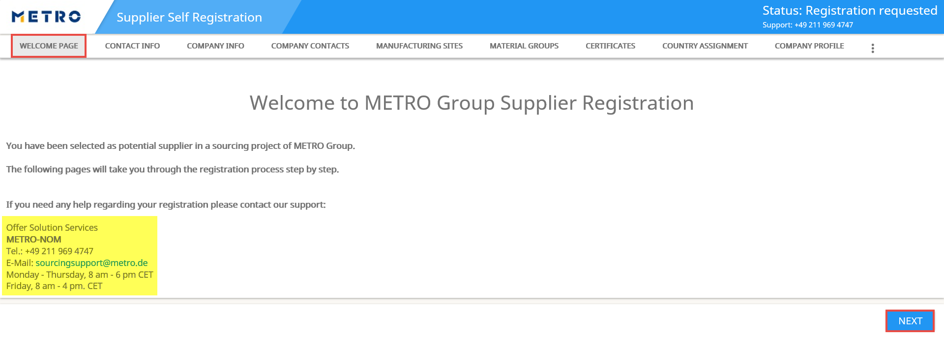
RegistrATION PROCESS – welcome page
Welcome to METRO Group Supplier Registration Form.
In this section you can also find the contact information, if you need help regarding your registration and/or eSourcing System.
Click on NEXT to continue.

Slide 7
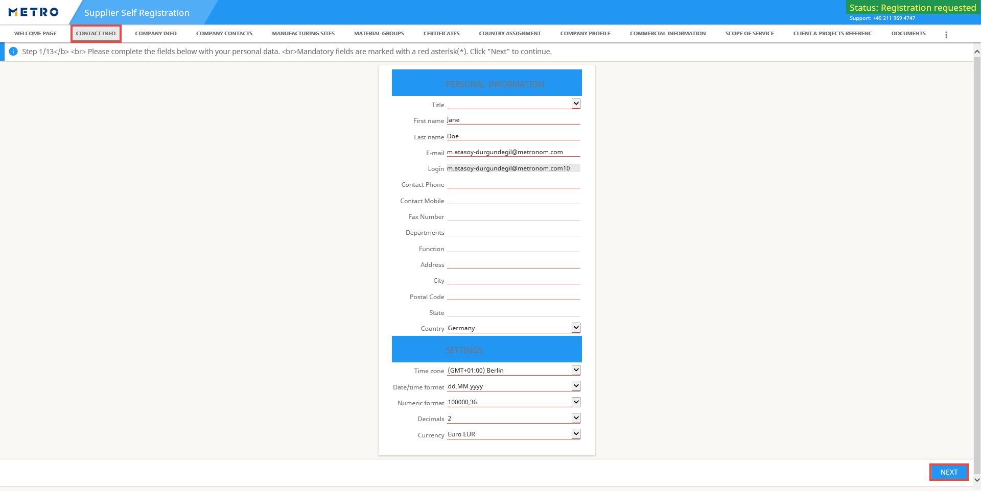
RegistrATION PROCESS 1/13 – CONTACT INFO
Enter your contact details.
Note: Red highlighted fields are mandatory to be filled.
Click on NEXT to continue.
Note: The status of your form is “Registration requested”

Slide 8
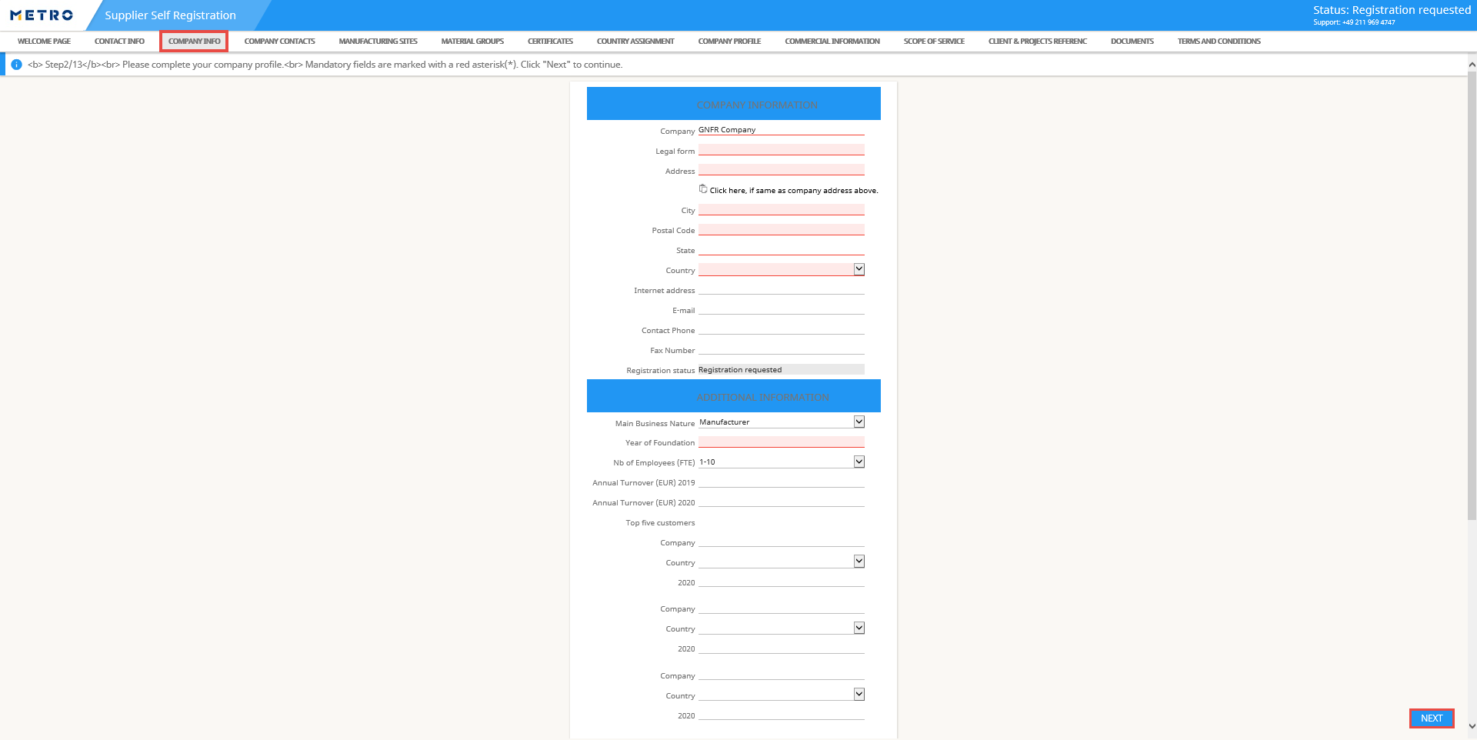
RegistrATION PROCESS 2/13 – company info
Enter your company information.
Note: Red highlighted fields are mandatory to be filled.
Click on NEXT to continue.

Slide 9
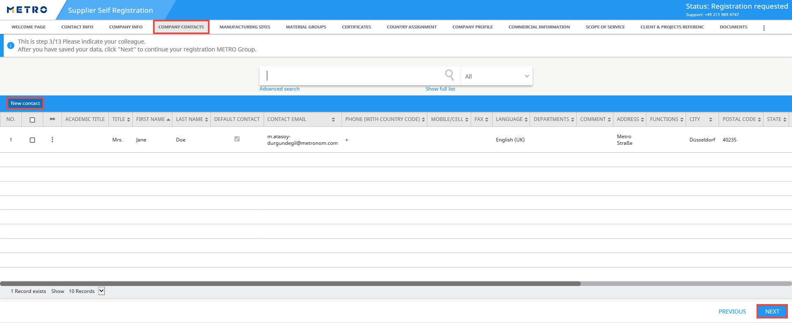
Registration process 3/13 – company contacts
You can enter the contact details of your colleagues.
Click on “New Contact” to add contacts.
When you complete with the entries, click on NEXT to continue.

Slide 10
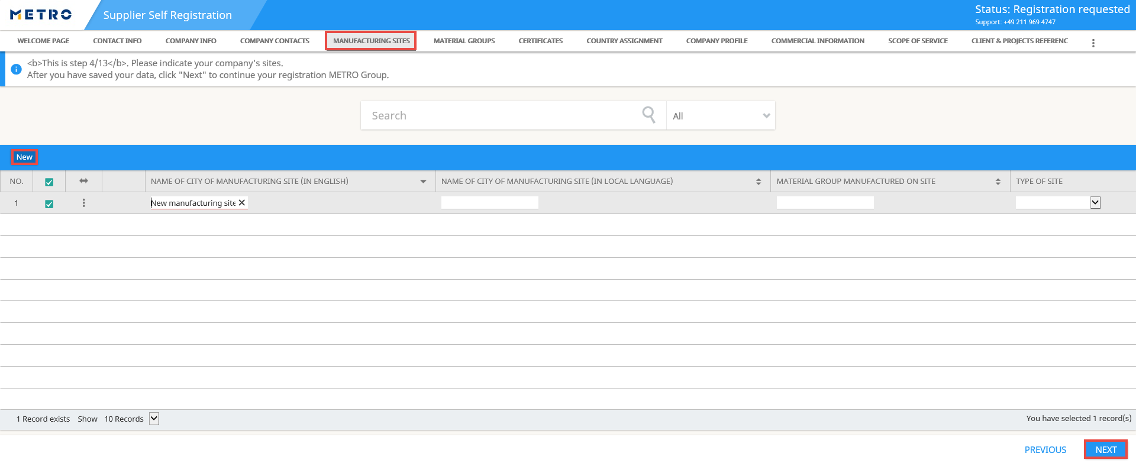
Registration process 4/13 – manufacturing sites
You can enter the manufacturing sites of your company, if applicable.
Click on “New” to add a new manufacturing site.
When you complete with the entries, click on NEXT to continue.

Slide 11
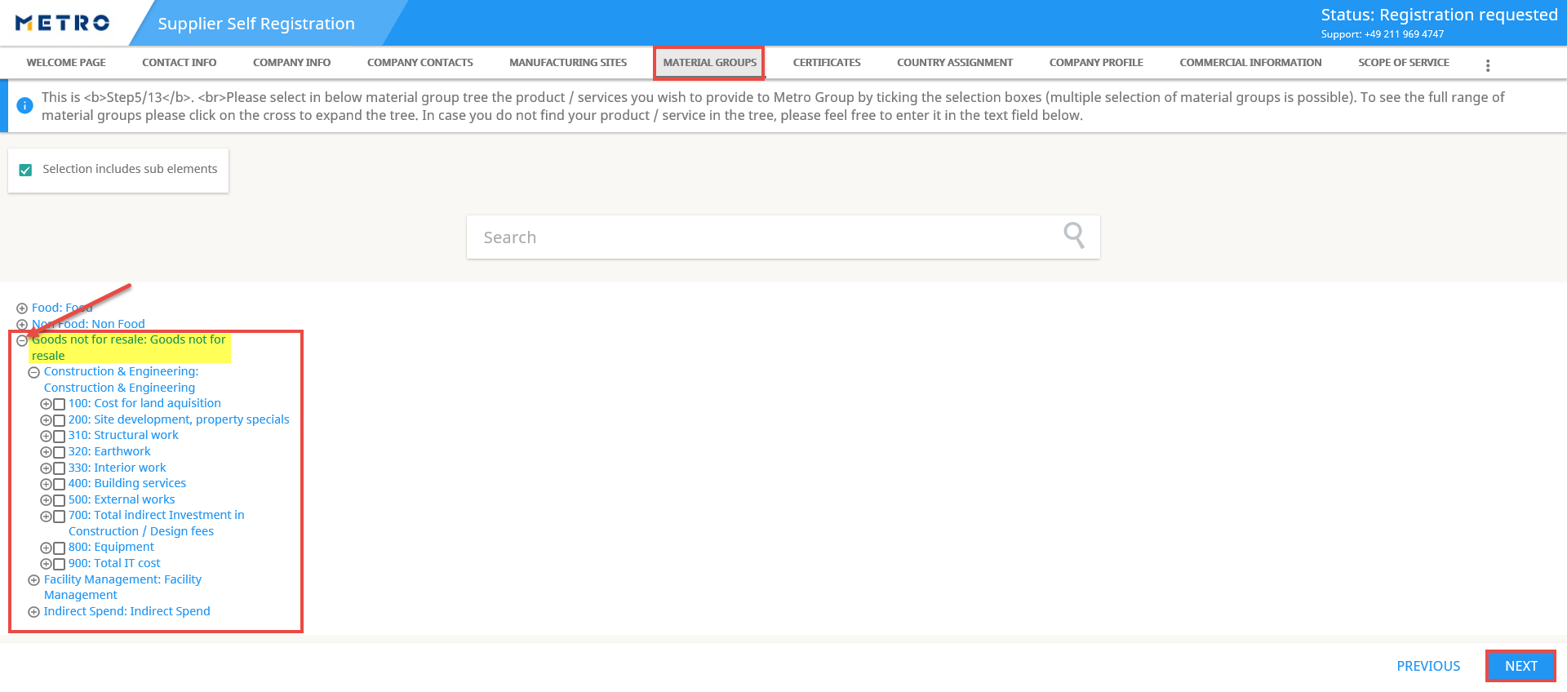
Registration process 5/13 – material groups
Select your GNFR material group by clicking on the to extend the list and further subgroups (Mandatory step).
You can also use the Search field.
Multiple selections are applicable.
Click on NEXT to continue.

Slide 12
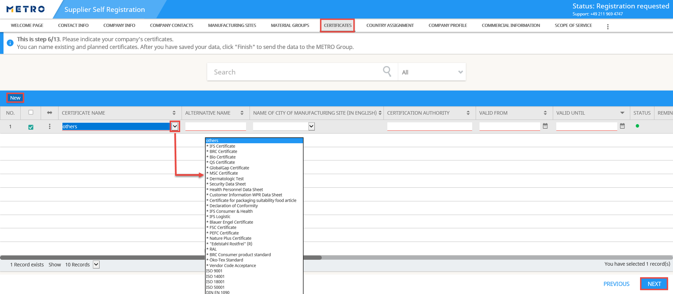
Registration process 6/13 – certificates
You can list the certificates of your company using the drop-down button, if applicable. Please complete the rest of the information marked in red.
You can add further certificates with NEW.
Click on NEXT to continue.

Slide 13
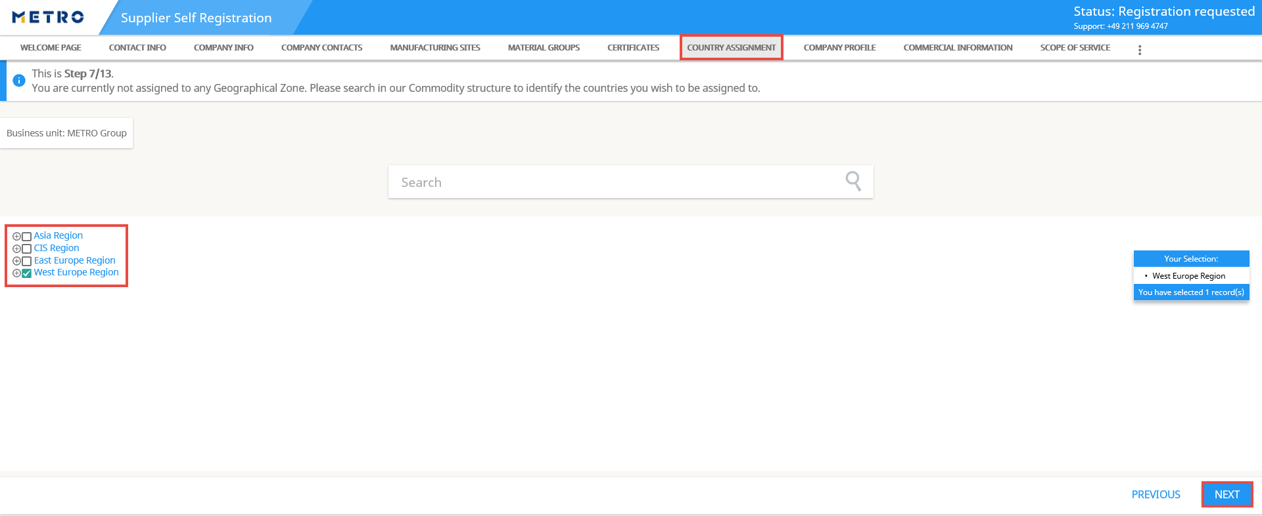
Registration process 7/13 – country assignment
Select the Geographical Zone of your company.
Click on NEXT to continue.

Slide 14
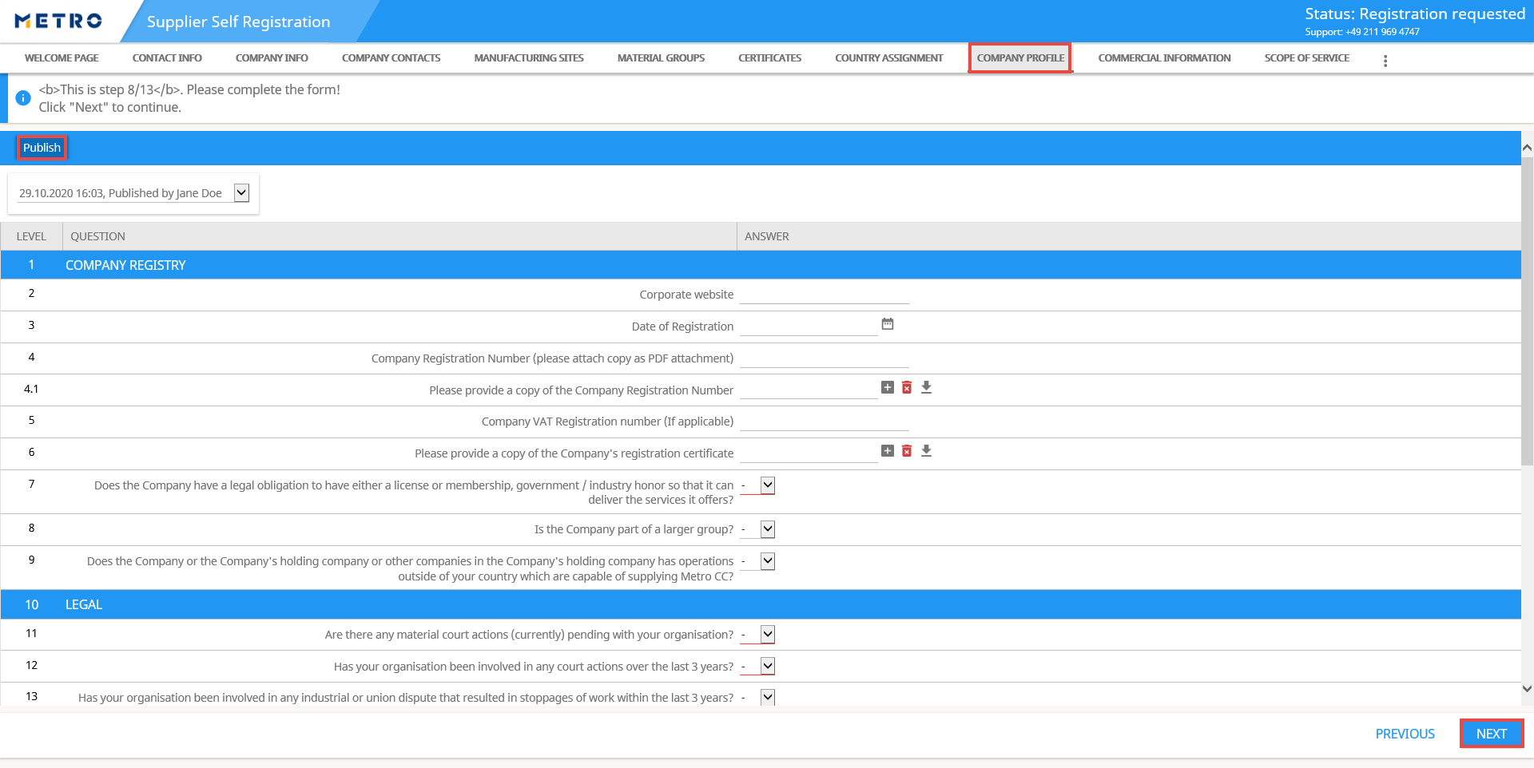
Registration process 8/13 – company profile
Fill out the questionnaire with your company information.
Note: Red highlighted fields are mandatory to be filled.
Click on Publish first and then NEXT to continue.

Slide 15
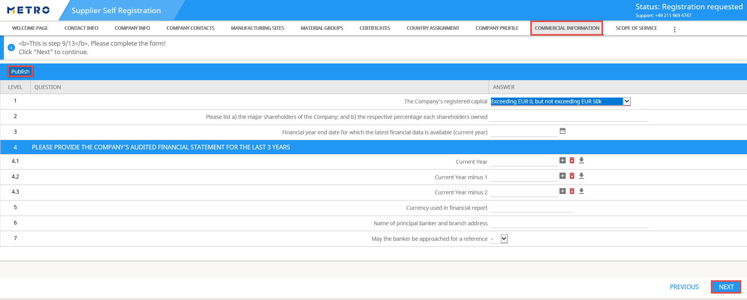
Registration process 9/13 – commercial information
Proceed with filling out the Commercial Information of your company
Note: Red highlighted fields are mandatory to be filled.
Click on Publish to save and then NEXT to continue.

Slide 16
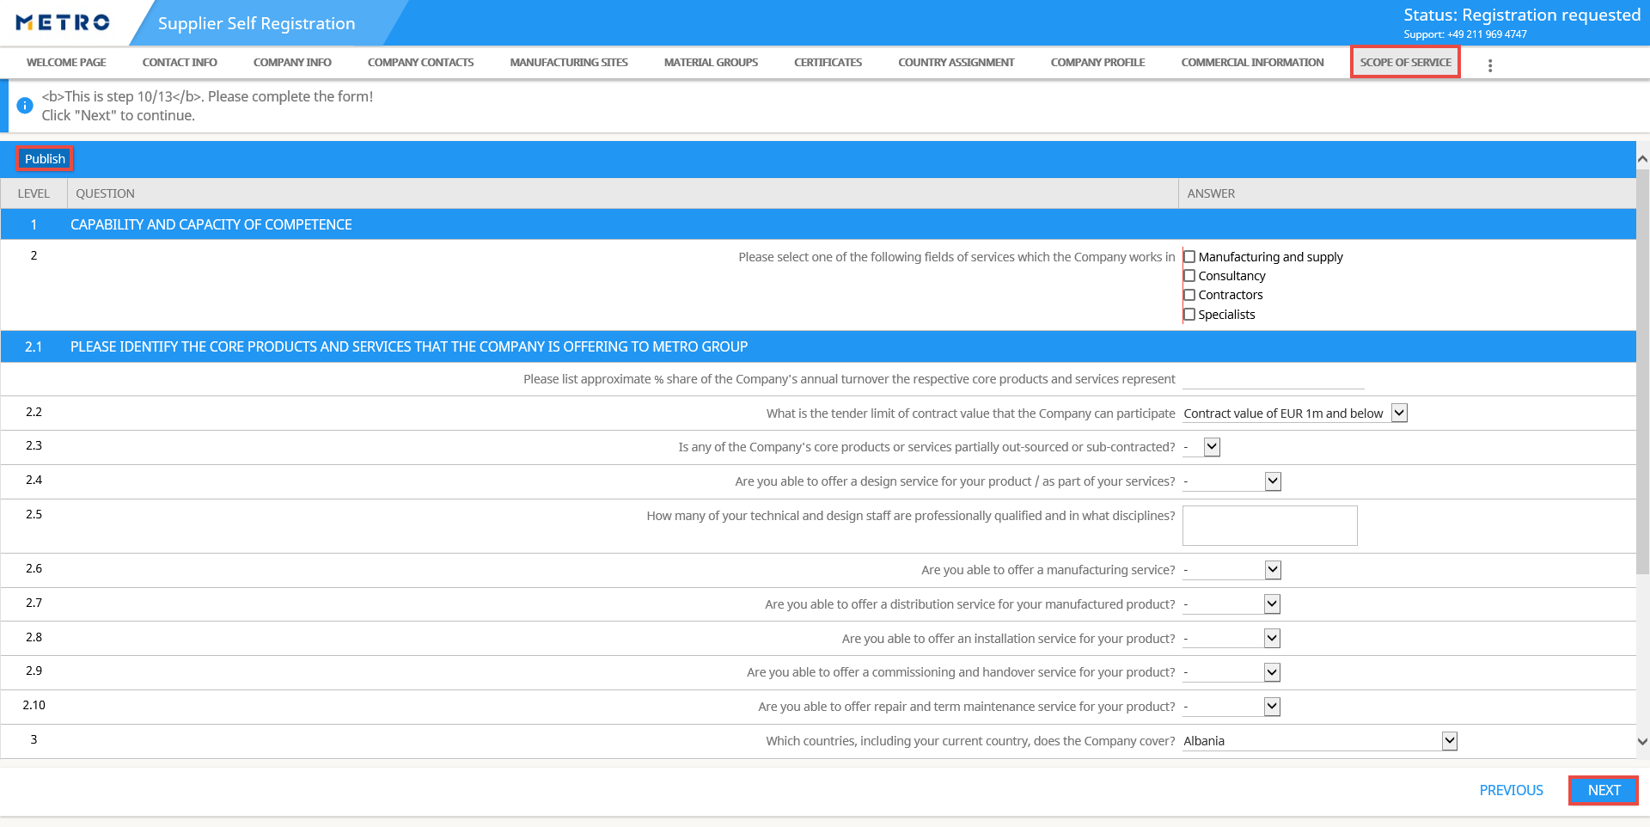
Registration process 10/13 – scope of service
Continue with filling out the questionnaire for your company’s Scope of Service.
Note: Red highlighted fields are mandatory to be filled.
Click on Publish to save and then NEXT to continue.

Slide 17
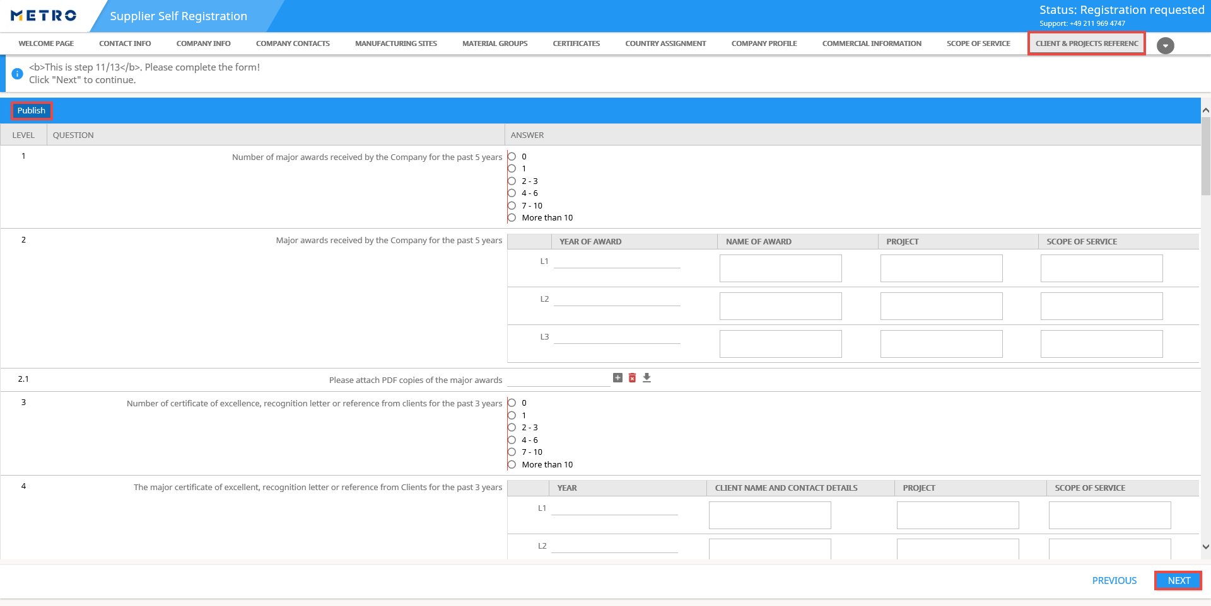
Registration process 11/13 – clients & projects reference
Complete to fill out the last part of the questionnaire regarding Clients & Projects Reference.
Note: Red highlighted fields are mandatory to be filled.
Click on Publish to save and then NEXT to continue.

Slide 18
Registration process 12/13 – documents
1. You can upload any documents which relate to your company under this section by clicking on "Upload".
2. Click on “Browse” to select the document(s) that you want to add.
3. Click on “Upload”.
4. Click on "Back to overview“
5. Click on NEXT to continue.

Slide 19
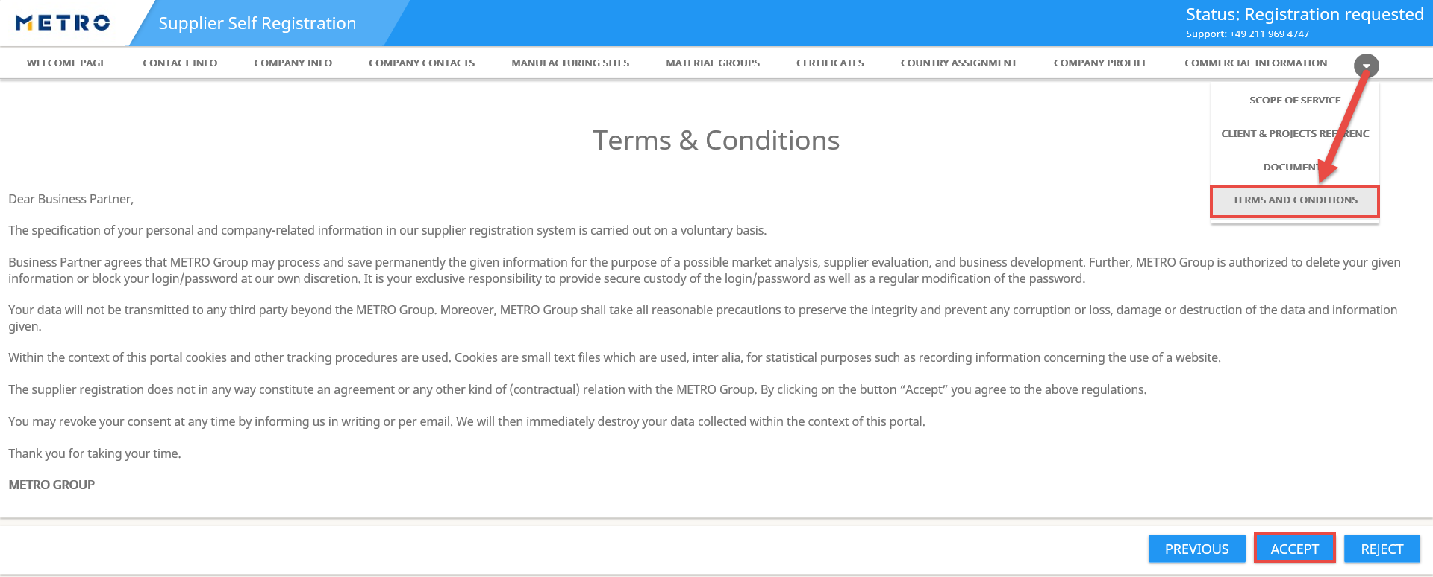
Registration process 13/13 – terms AND conditions
Before completing the registration, please check, whether you need to make any changes. In order to make changes, you can click on PREVIOUS.
To complete the registration process, click on ACCEPT.
Notes:
Wie funktioniert „Veröffentlichen“?
Bedeutung
Reihenfolge
-> René fragen.

Slide 20
Registration process – registration with success
The status of the registration changes from “Registration requested" to “Submitted“ as soon as accept the terms and conditions in the previous page.
Your data will be immediately sent to the responsible buyer from buying department and you will be soon contacted by the METRO Group.
Notes:
Wie funktioniert „Veröffentlichen“?
Bedeutung
Reihenfolge
-> René fragen.

Slide 21
Contact
If you need any support for using the eSourcing platform, please do not hesitate in contacting us.
Office Solution Services Team
esourcing@sourcingsupport.de
Hotline: +49 211 969 4747
Mo. – Thu.: 08:00 to 18:00
Fri.: 08:00 to 16:00
Notes:
Kontaktfolie Verwenden Sie die Layoutoption „Kontakt“, wenn Sie eine neue Folie über den „Start“-Reiter erstellen wollen.
Die Hintergrundfarbe, das Markenzeichen und die Grafik sind auf diesem Folienlayout voreingestellt und dürfen nicht verändert werden.
Der Titel erscheint in Verdana fett 36 pt und in weißen Versalien. Weitere Kontaktdaten sollten in Verdana Standard 15 pt (weiß) wie in diesem Beispiel erscheinen.

